Slide 1
Rīga Stradiņš University
March 2023

Slide 2
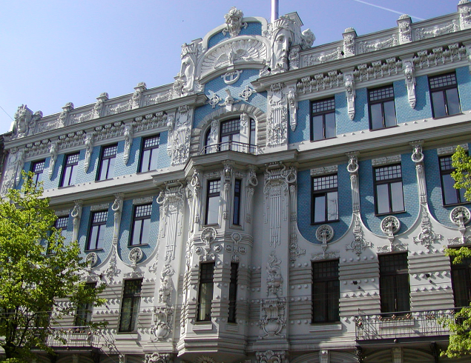
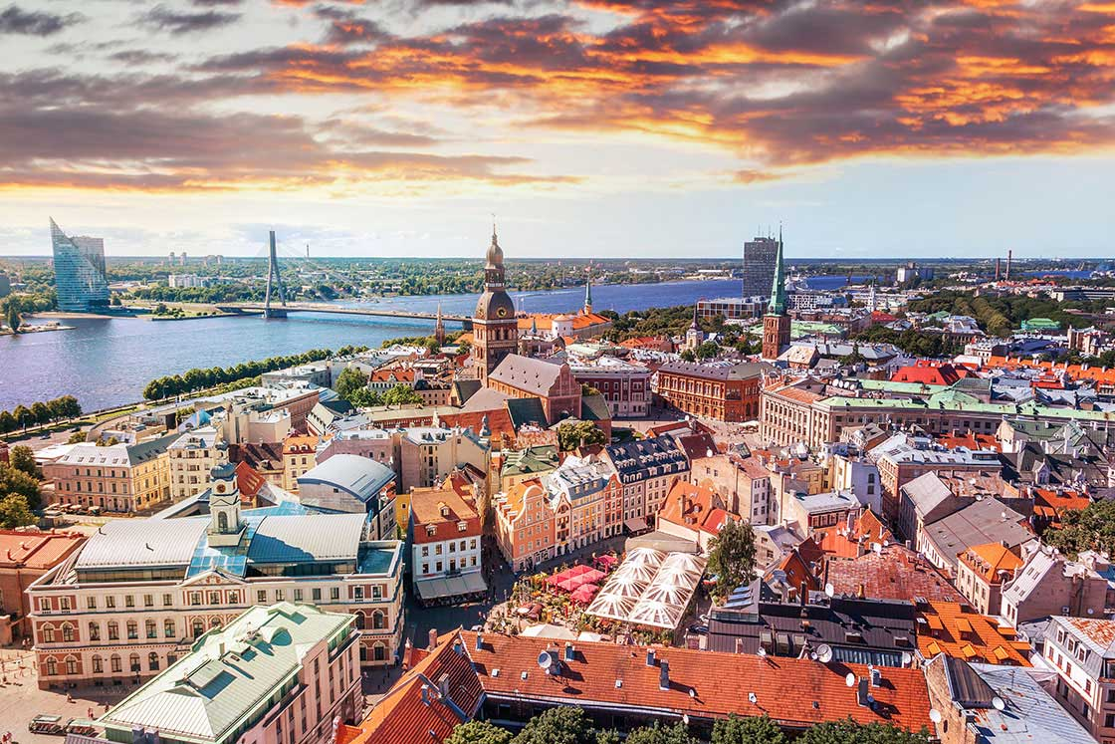
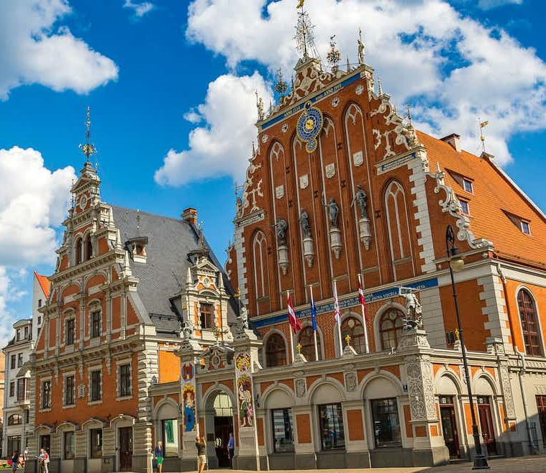
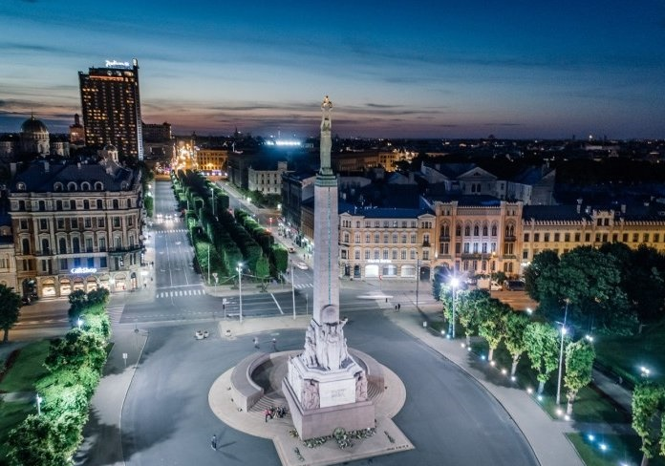
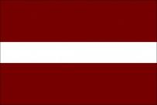
Latvia
Area: 64.589 sq km
Population: 1.9 million
Density: 29.6/km²
Official Language: Latvian
Other languages: Russian, English, German
Latvia is a member of the European Union and NATO
Currency: Euro
Welcome to RSU & Latvia!

Slide 3
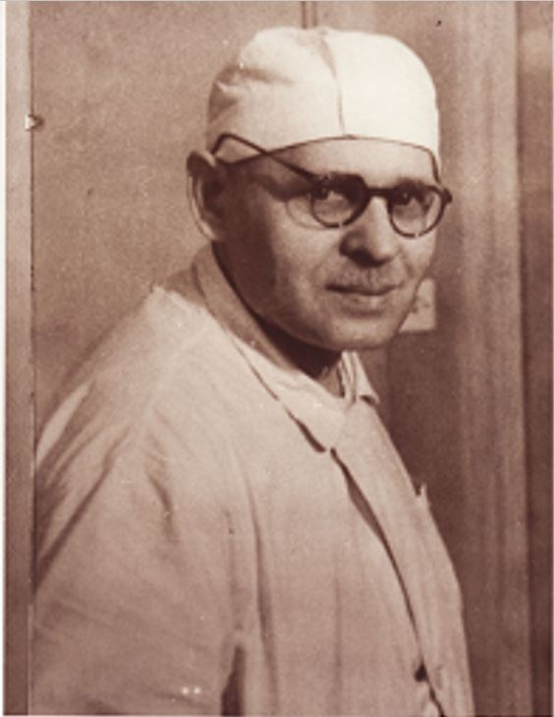
RSU Name
Professor Pauls Stradiņš (1896-1958) was the leading and most prominent figure in medicine and medical education in Latvia.
The founder of Rīga Medical Institute (RMI)
1923, 1927: Doctor of medicine
1931-1941: Director of Riga 2. Hospital
1938: The founder of Cancer Hospital
After WWII: Reorganisation of medical education in Latvia
1950: Director of RMI Surgery Department
Since 1953: Head of the Union of Medical Historians in Latvia

Slide 4
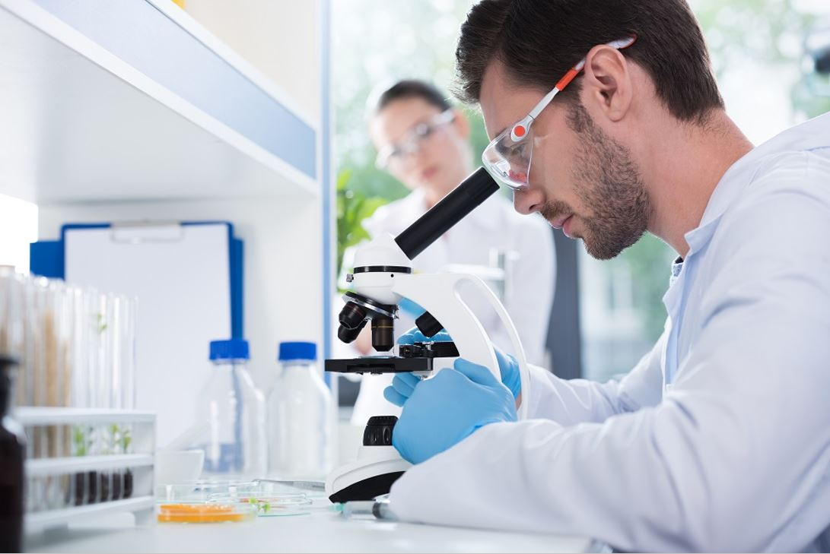
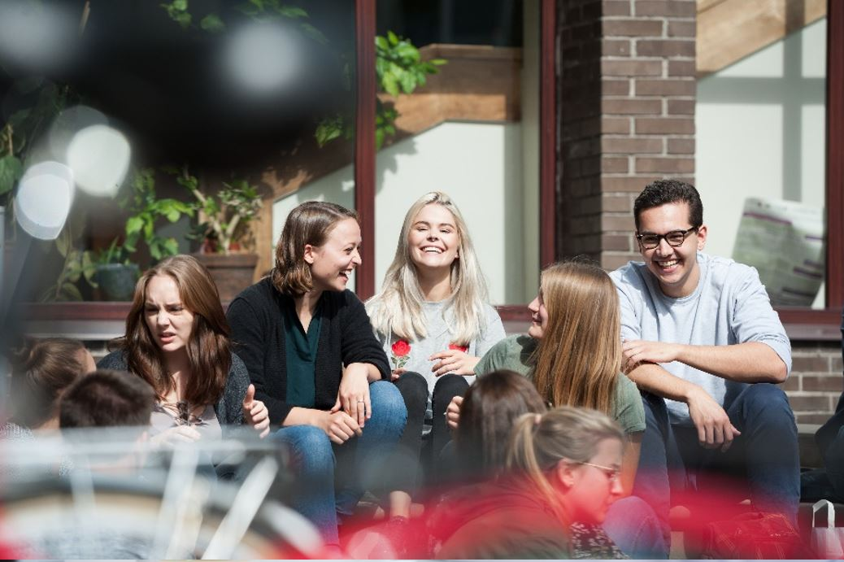
RSU in Figures #1
9 659 students in total
65 study programmes (9 in English)
2 674 international students
27.7% of the student body
75 countries represented
State owned public university
Diplomas recognised in the EU/EEA
Small study groups (8-14 students)
2000 international graduates

Slide 5
RSU in Figures #2
International Students

Slide 6
RSU in Figures #3
International Students

Slide 7
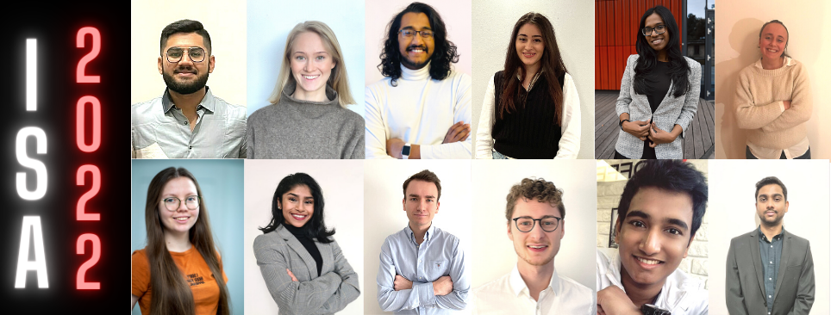
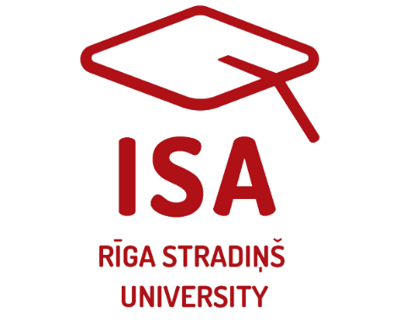
Student Centeredness
Individual work in practical classes
Easy access to library, study materials, presentations, WiFi
Extracurricular events and activities
Academic activities
Scholarships, ERASMUS exchange
17 International student organisations (German, Swedish, Asian Society, Dutch, Italian, Portuguese, Norwegian, Finnish, British, Kurdish, etc.)
International Student Association

Slide 8
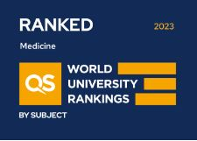
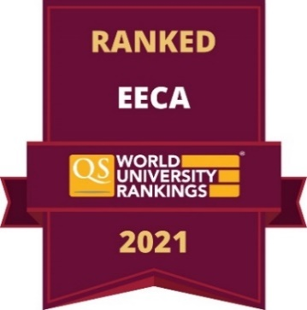
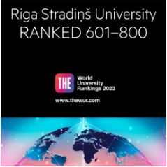
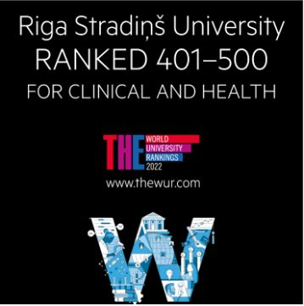
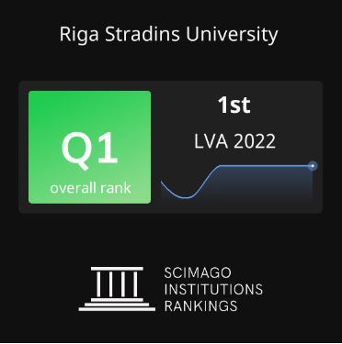
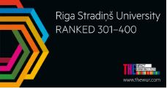
RSU Rankings
# 801-1000
# 501-550
# 119
# 641, 1st in Latvia

Slide 9
Study Programmes in English
Health/Life Sciences | Social Sciences
Professional | Bachelor’s
1. Medicine (MD) | 1. International Business and Start-up Entrepreneurship
2. Dentistry (DDS)
Master’s | Master’s
1. Social Work With Children and Youth | 1. International Governance and Diplomacy
2. Health Management | 2. Russia and Eurasia Studies
3. Biostatistics

Slide 10
Study Programme «Medicine»
Study Programme «Dentistry»
Study length:
6 years, 360 ECTS
Study type:
Full-time studies in English
Study process:
Basic/Theoretical (year 1-2)
Preclinical (year 3)
Clinical (years 4-5)
Practical (year 6)
Degree conferred:
Medical Doctor
Career opportunities:
All fields of medicine, scientific and research institutes, universities & academic institutions
Study length:
5 years, 300 ECTS
Study type:
Full-time studies in English
Study process:
Basic/Theoretical (year 1)
Preclinical (year 2)
Clinical (years 3-5)
Degree conferred:
Doctor of Dental Surgery
Career opportunities:
Orthodontics, Paediatric dentistry, Periodontology, Endodontics, Prosthodontics

Slide 11
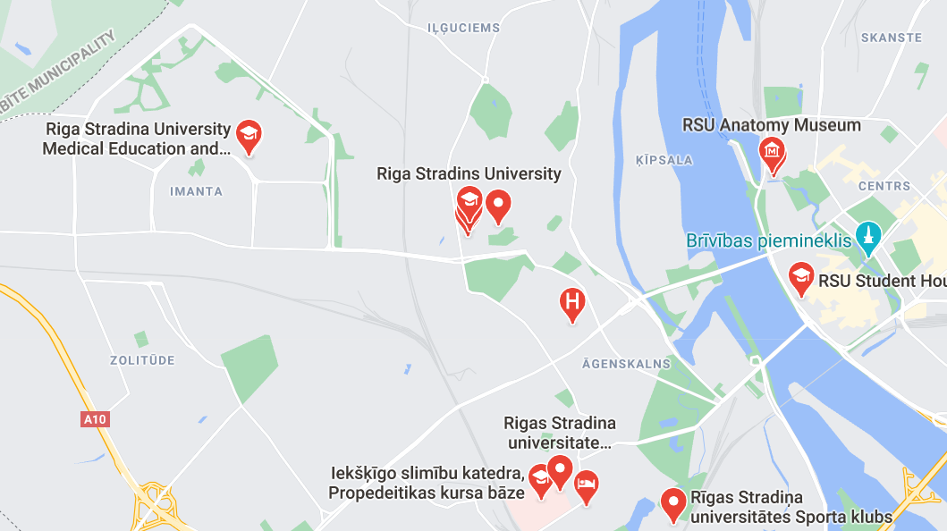
RSU and Riga

Slide 12
Application Documents
Online application
High school diploma + transcript
Original language
English translation
English proficiency certificate
2 letters of recommendation
Letter of motivation
Copy of passport
Photo
100 EUR payment slip
Application deadlines
1 July 2023 for September 2023
(>360 Medicine + >60 Dentistry)
1 December 2023 for February 2024
(240 Medicine +28 Dentistry)

Slide 13
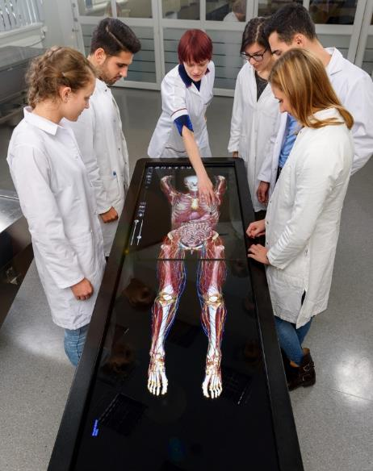
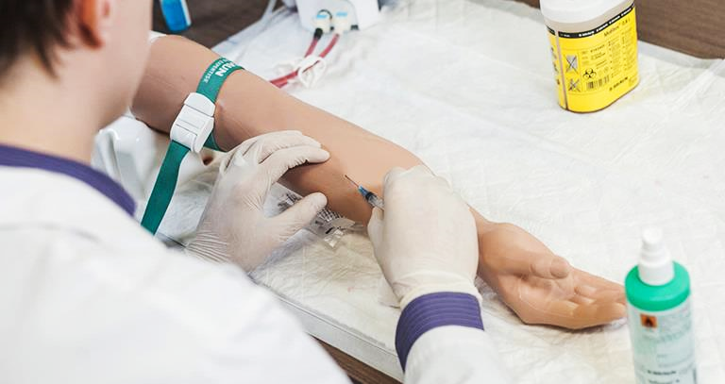
Admission Criteria
Full application submitted by the deadline
Completed secondary education
At least 70% or higher grade in the programme-specific subjects:
Biology and/or Chemistry
English
Mathematics*
Letters of recommendation and motivation
Additional certificates
practices, internships, degrees, courses

Slide 14
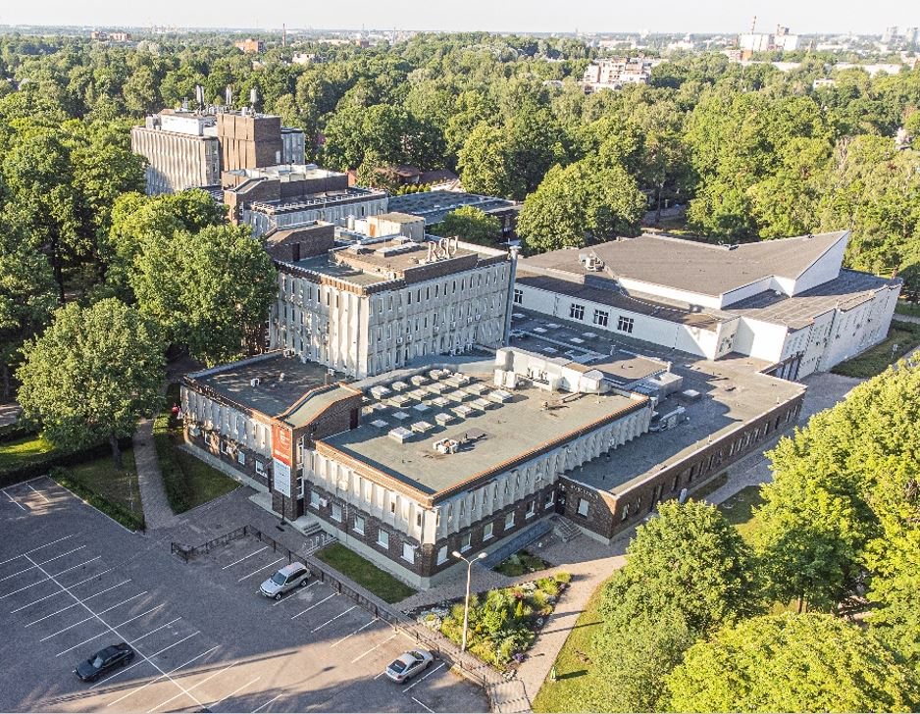
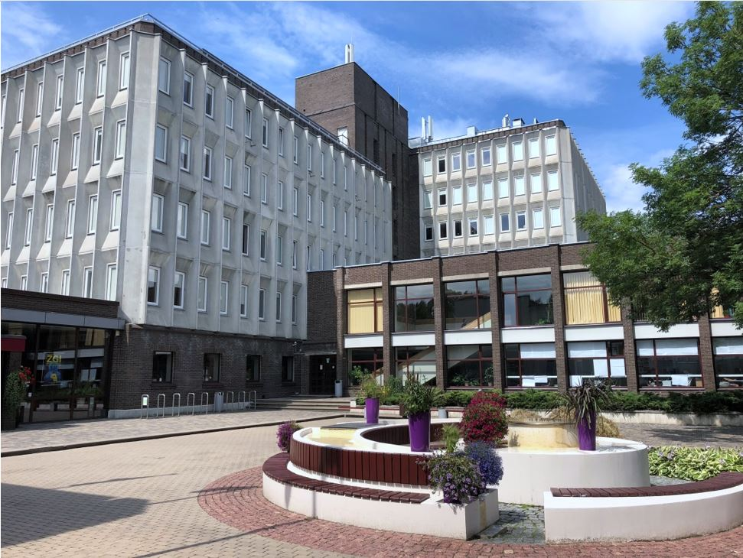
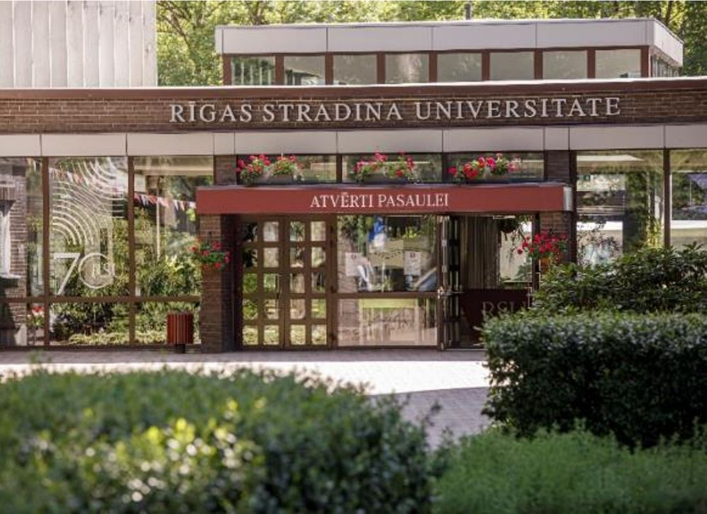
RSU Main Building

Slide 15
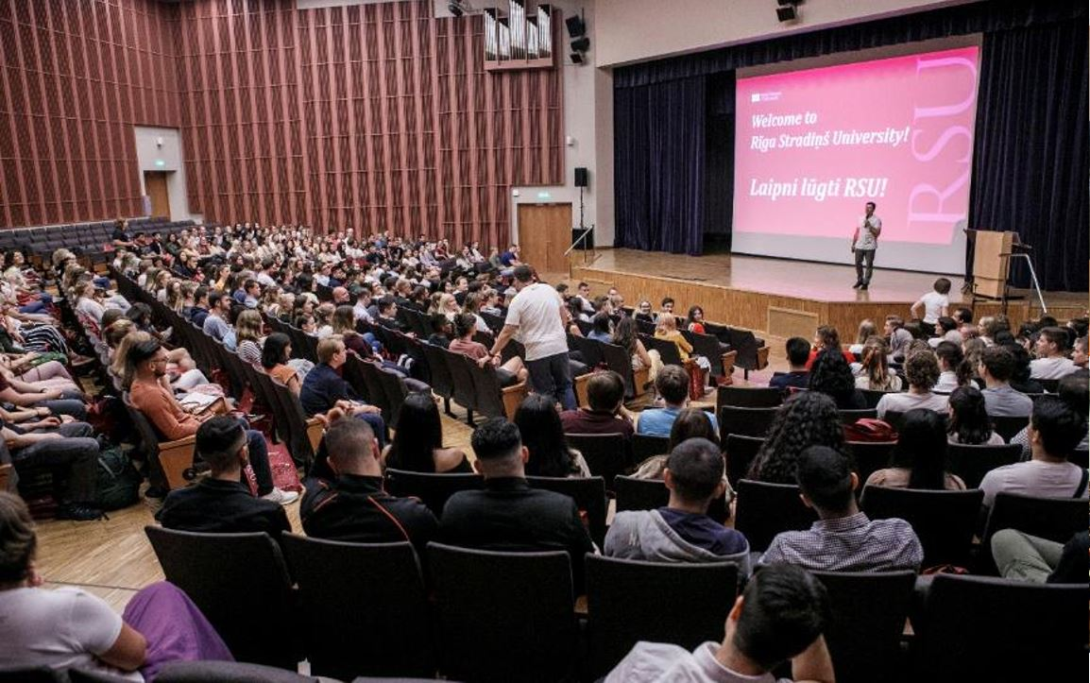
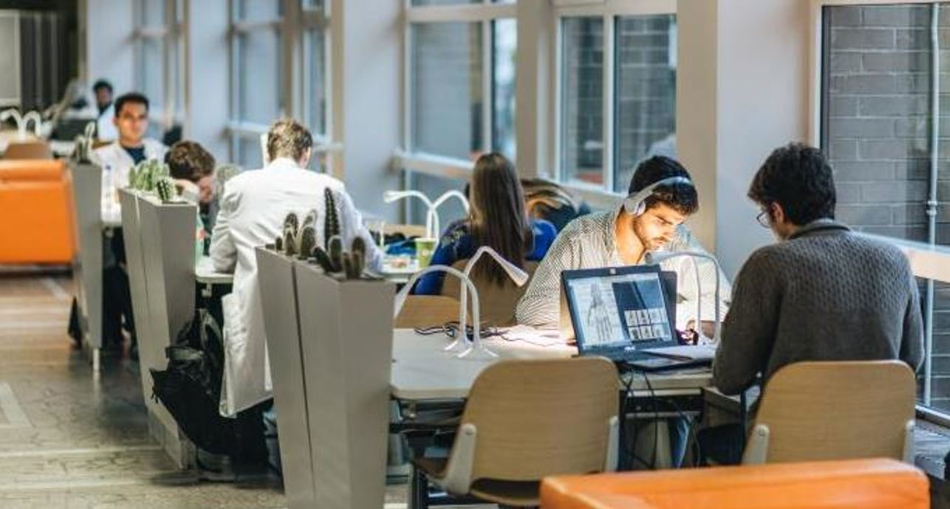
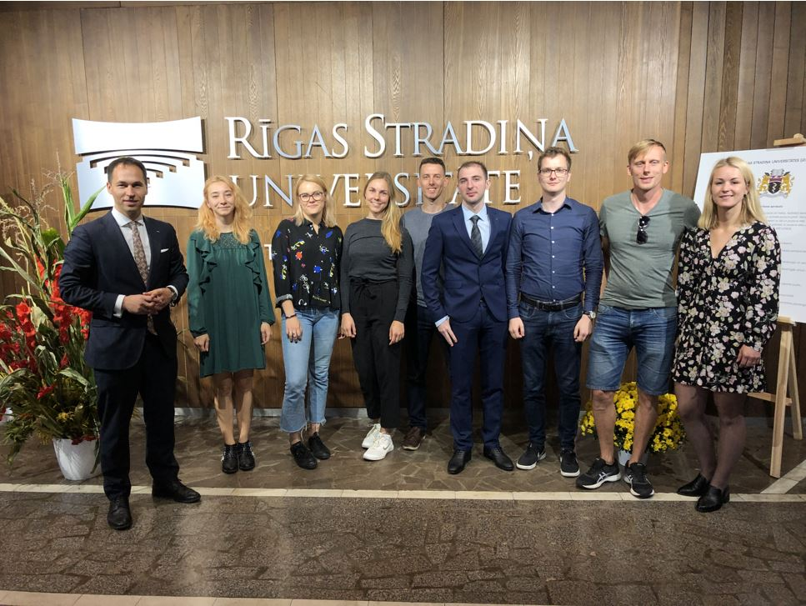
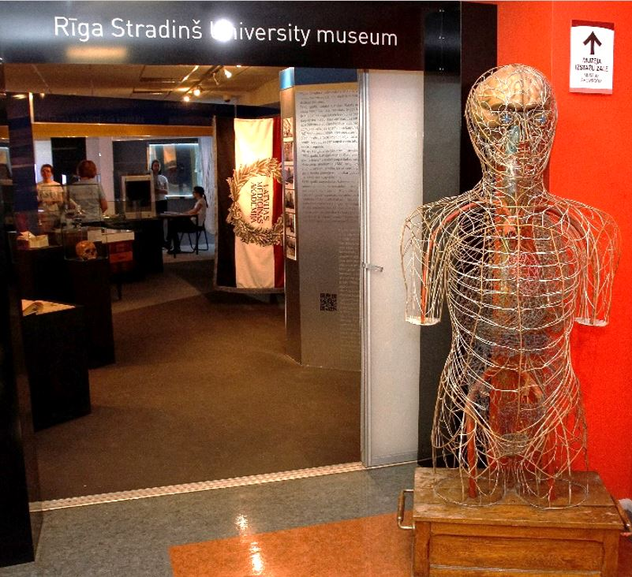
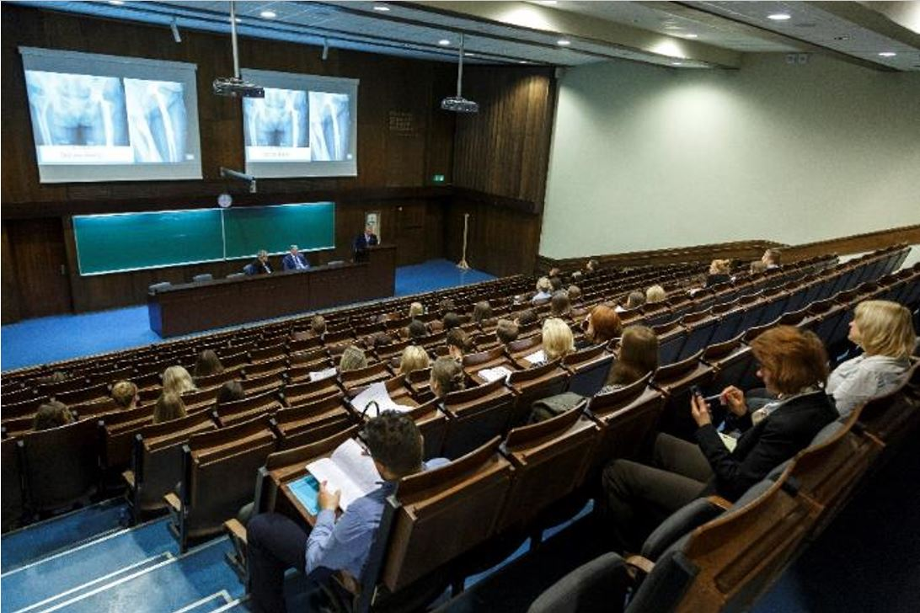

Slide 16
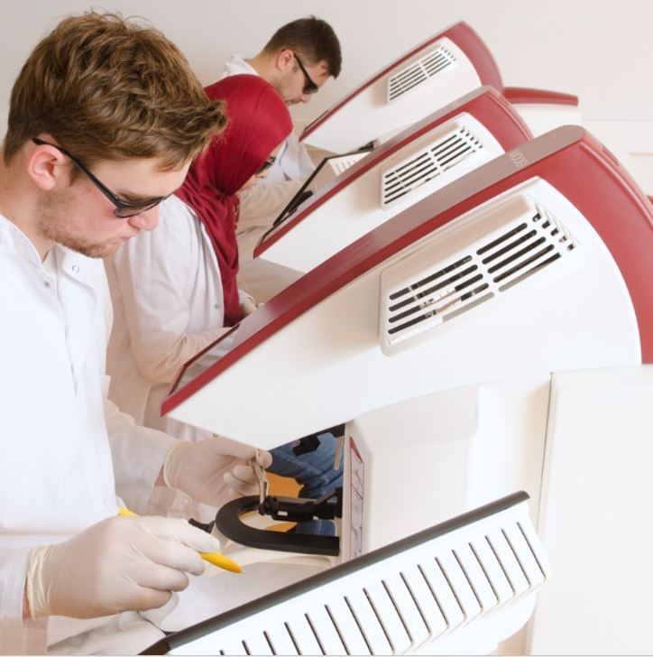
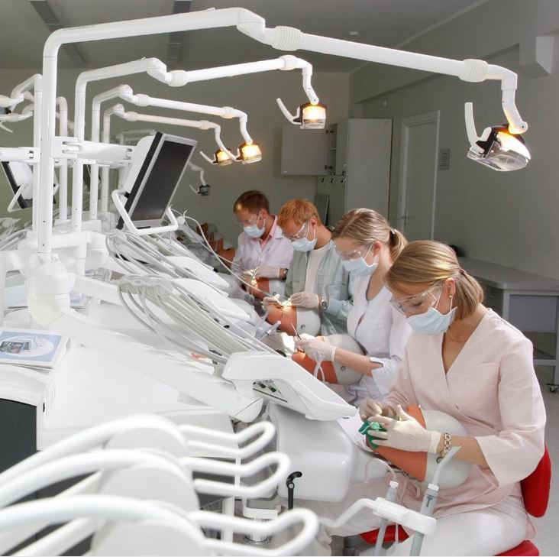
RSU Main Building (Dentistry Pre-clinic)

Slide 17
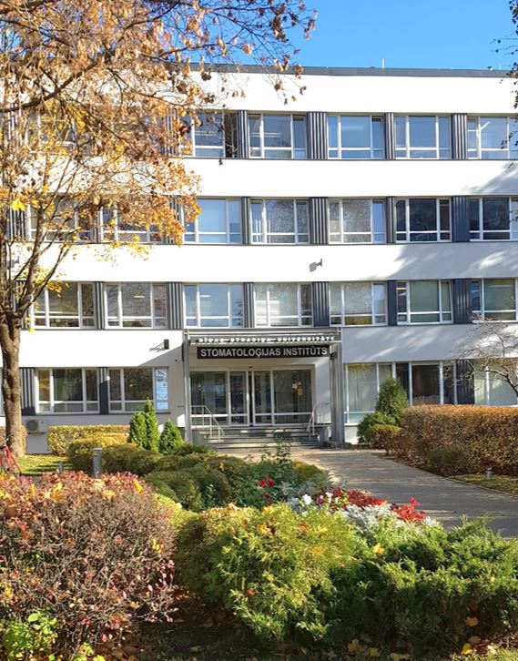
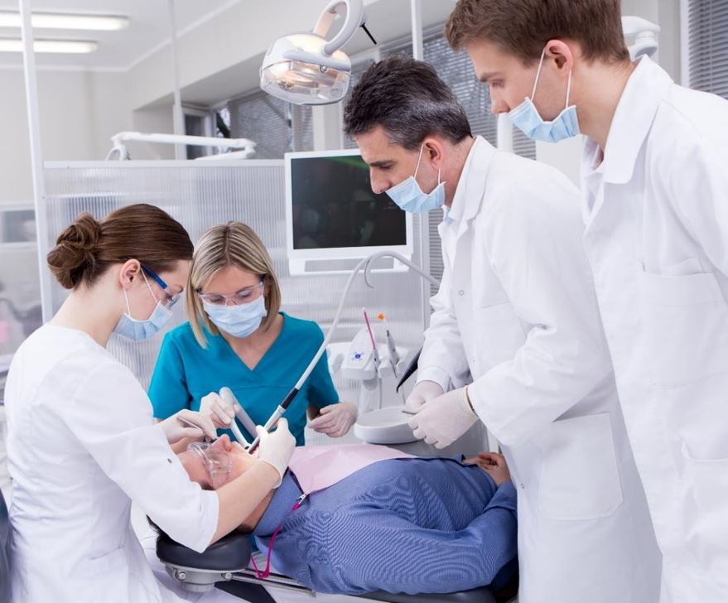
RSU Institute of Dentistry

Slide 18
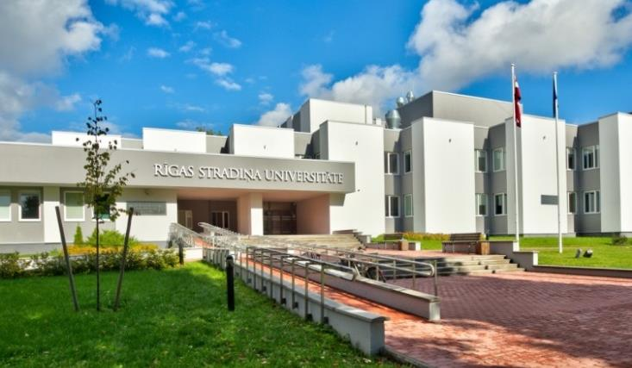
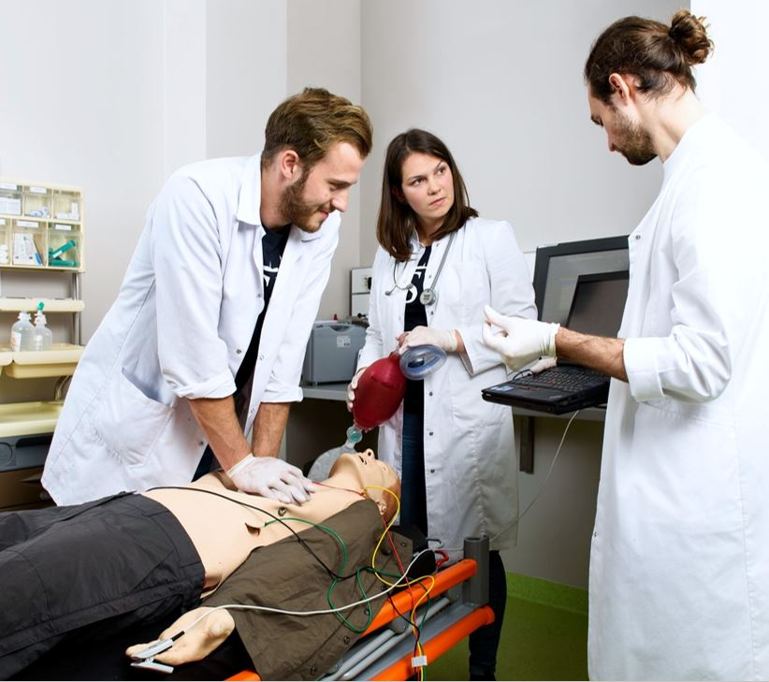
RSU Medical Education and Technology Centre (METC)

Slide 19
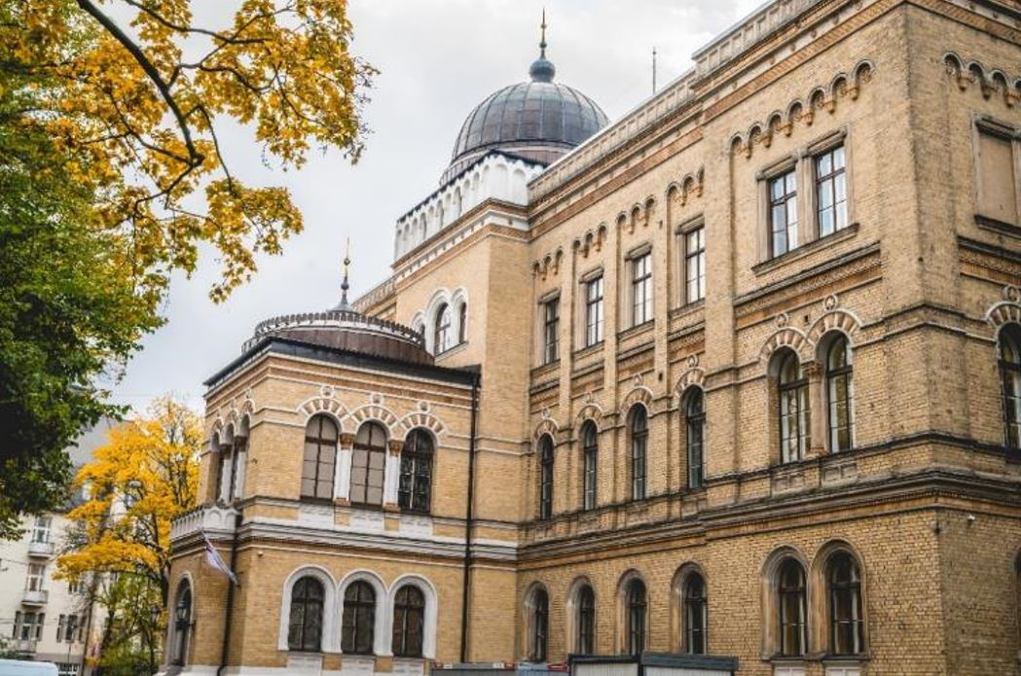
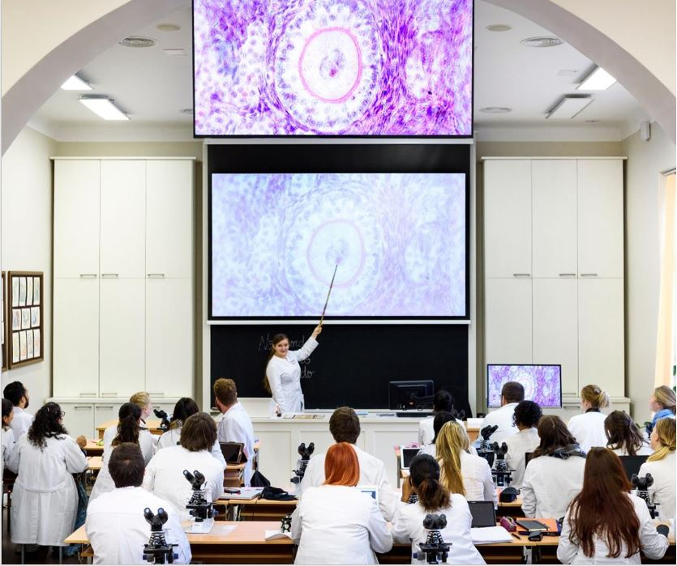
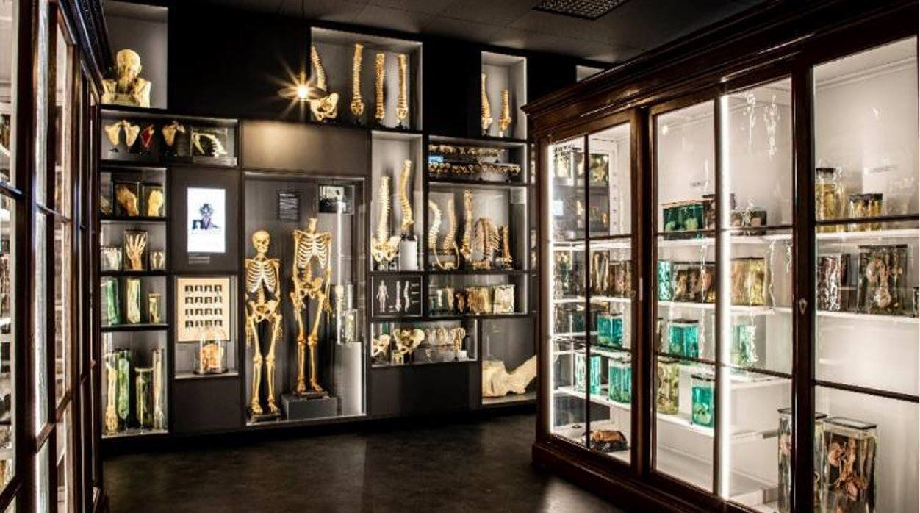
RSU Anatomy Centre (Theatrum Anatomicum)

