Slide 1
Physics about Cognition:
a Modern Approach to Ageless Argument
Igor Val Danilov

Slide 2
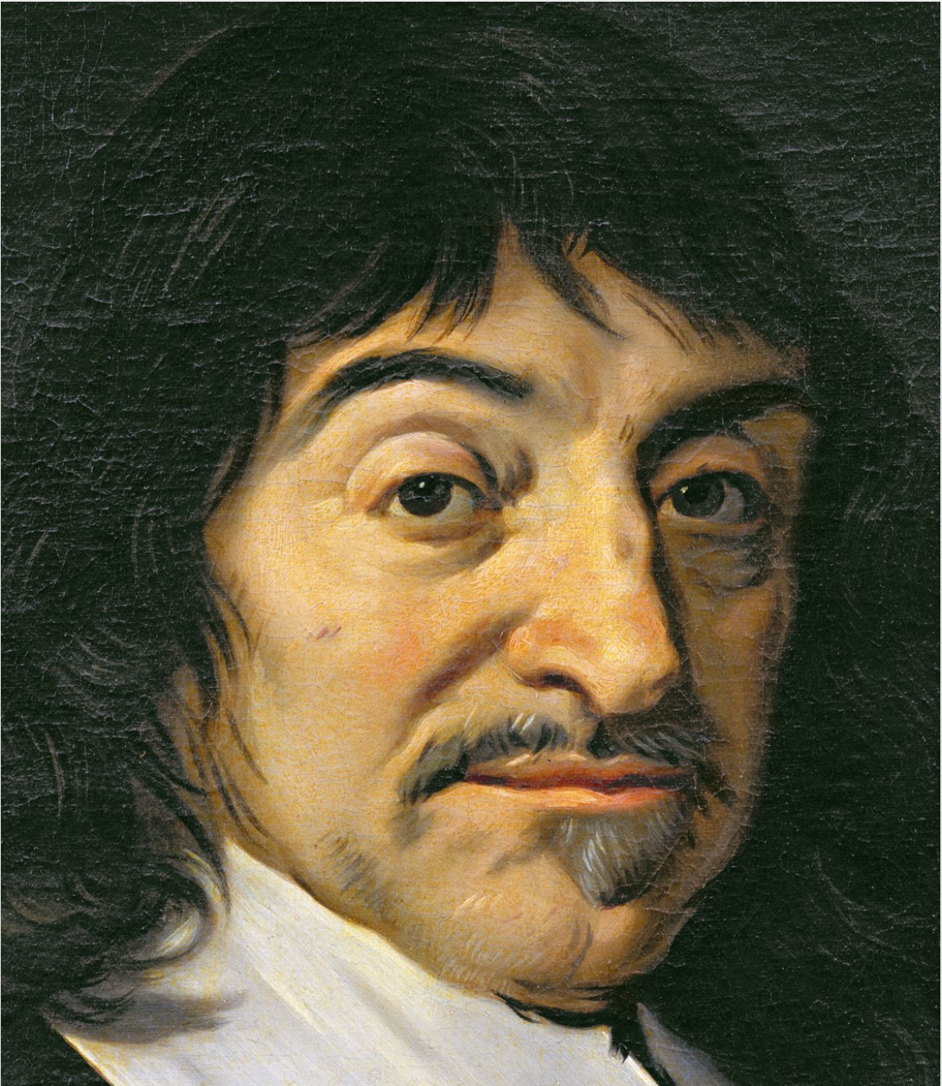
THE ARGUMENT
What – Nature or Nurture – does drive cognitive development at the beginning of life?
The current presentation attempts to discuss the ageless argument of Nature vs. Nurture in cognitive development from the physics point of view.
It will show you neurophysiological processes in organisms that can enable the "blank mind" to begin cognition even in the prenatal period.

Slide 3
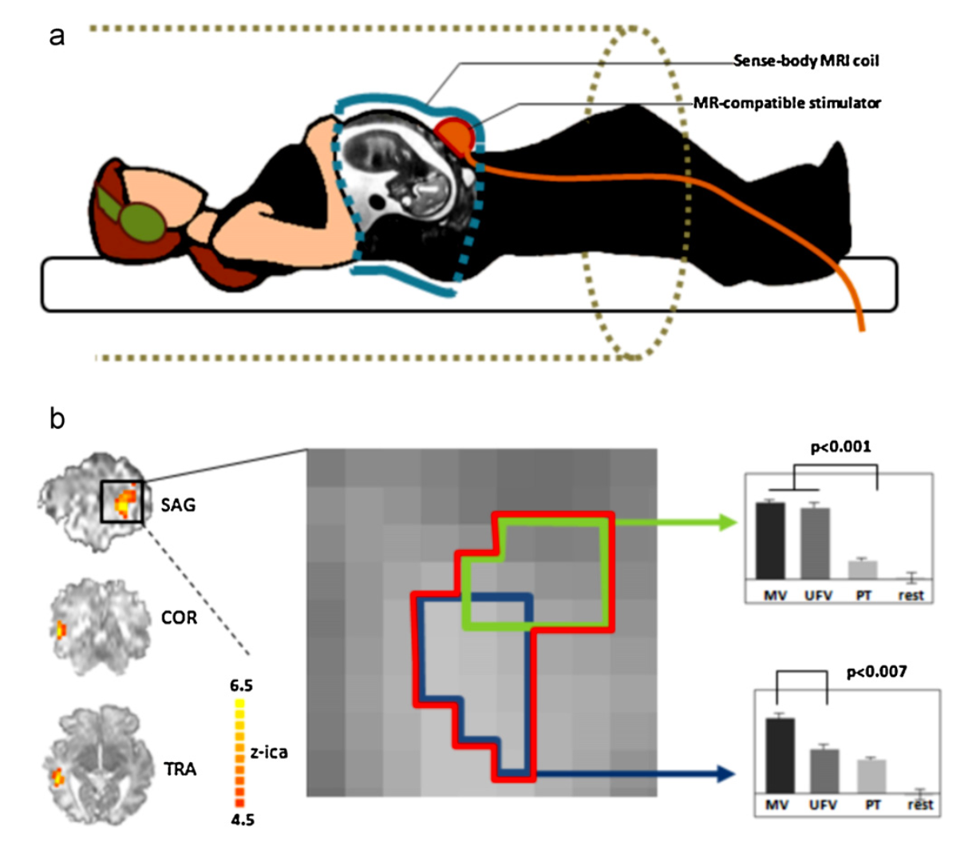
What do we know about cognition?
Review of the literature shows that the movements of fetuses seem intentional [1].
The intra-pair movements of the twins are an even higher degree of accuracy [2],[3].
Single fetuses show an ability for voice recognition [4]–[8].
Fetuses distinguish a change in the gender of a speaker reading a sentence [8].
Fetus can discriminate sounds (e.g., speech sounds—”babi” and “biba”) [9].
They can learn frequently heard sounds (e.g., voices, music) and flavors it experiences in the womb[9].
Neuroscience research studies revealed the underlying mediation of the behavioral responses seen in response to language and voice stimuli [9]. At 33 weeks of gestation, activity increased in the left temporal lobe of the fetal brain when it was exposed to an unfamiliar female voice compared with pure tones [9],[10].
At 34 weeks GA, the lower bank of the temporal lobe was significantly more active during exposure to a maternal voice than to an unfamiliar female voice [9],[10].
The data show beginning of perception development even at the first trimester of pregnancy.
There are at least two problems in cognitive development of fetuses: Binding problem and Morphology problem.
Fetal brain responses to auditory stimuli (Jardri et al., 2012) [10]

Slide 4
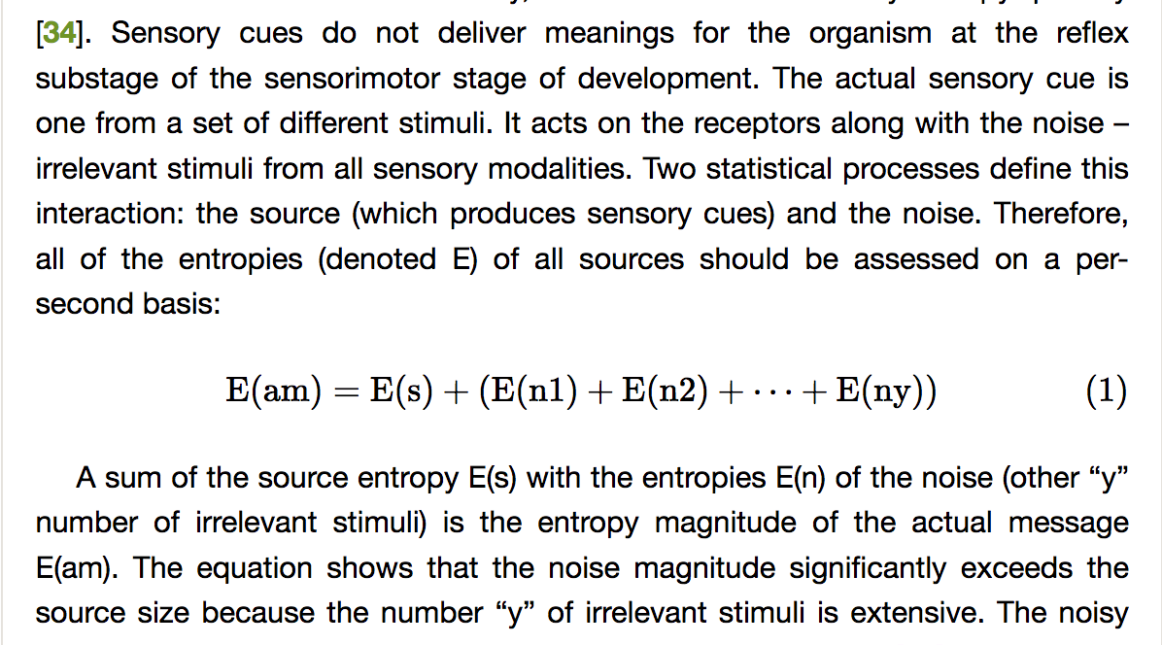
Binding problem
How can an organism with only simple reflexes distinguish the relevant stimulus in the chaos of others: electromagnetic waves, chemical interactions, and pressure fluctuations?

Slide 5
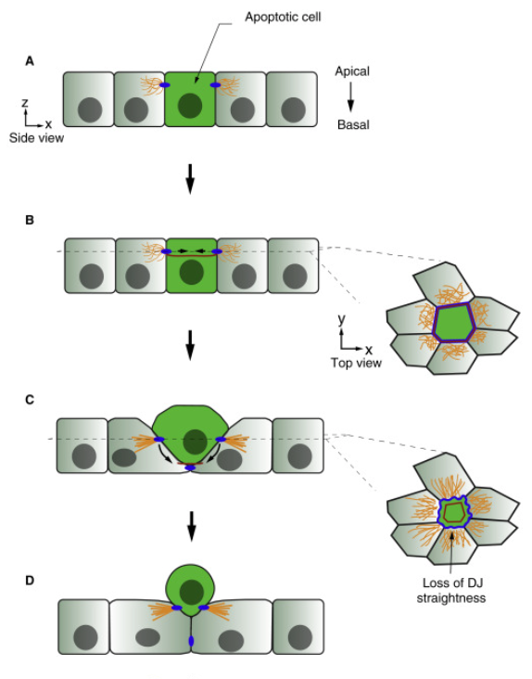
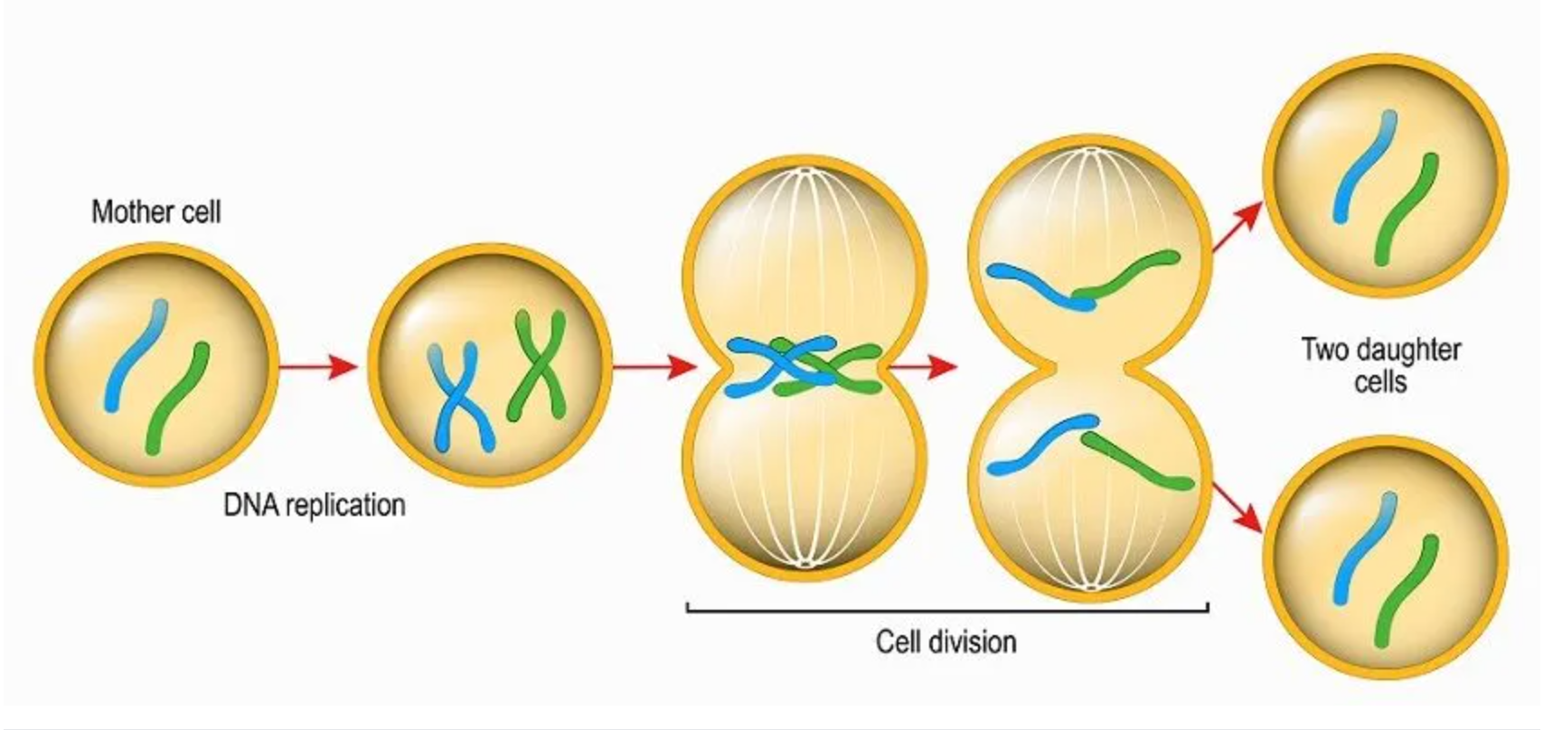
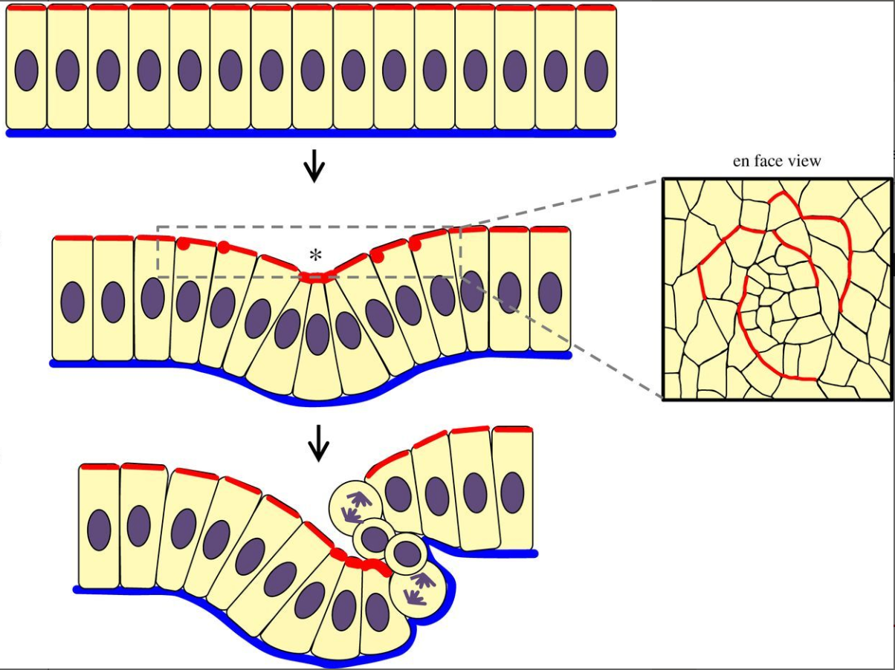
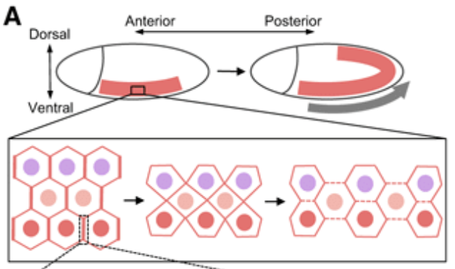
Morphology problem
'Tissue dynamics arise from a small set of cell behaviours, including shape changes, cell contact remodelling, cell migration, cell division and cell extrusion. These behaviours require control over cell mechanics, namely active stresses associated with protrusive, contractile and adhesive forces, and hydrostatic pressure, as well as material properties of cells that dictate how cells respond to active stresses.[11]'
Collinet and Lecuit (2021) highlighted a lack of knowledge about what forces at the cellular level manage four very general classes of tissue deformation, namely tissue folding and invagination, tissue flow and extension, tissue hollowing, and, finally, tissue branching[11]? It is not only the interaction of gene activity with events and experiences in the environment that contributes to the formation of tissues in morphogenesis [11].
Cell division
Cell extrusion
Tissue folding and invagination (Esther et al., 2017)
Tissue extension
(Uechi and Kuranaga, 2017)

Slide 6
What do we know about cognition?
What intrinsic quality of biological systems can provide a template for building an adequate nervous system structure in an embryo carrying out such a brain activity that would be both necessary and sufficient for relevant biological sentience in the specific environment?
If we can define the intrinsic quality that stimulates such brain activity, we can also determine the neurophysiological processes that contribute to mental activity at the beginning of cognition.

Slide 7
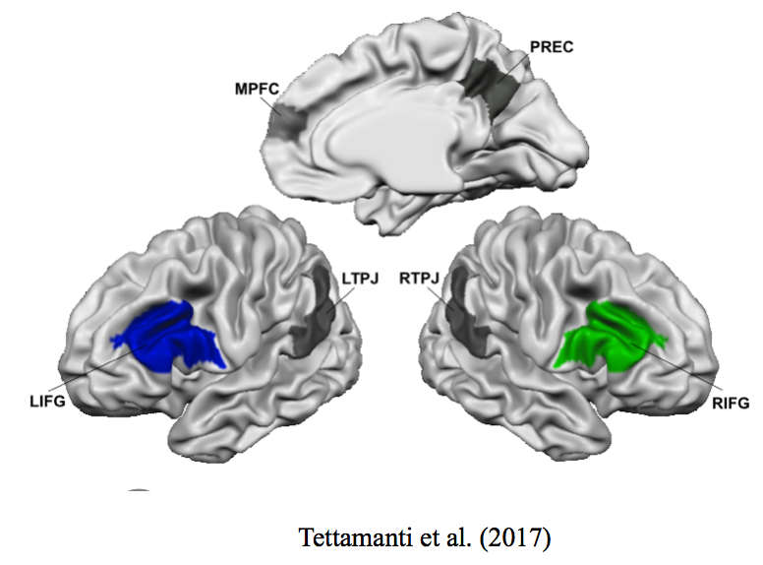
What we know about mental activity
The resulting correlated activity between brain regions emerges either from direct neural connections between the regions, common input from the thalamus and other neocortical regions, or both [13].
However, neuronal temporal coordination also occurs between distant cortical structures that are not necessarily interconnected anatomically [14].
Network temporal coordination is crucial in interacting with different brain regions [15,16,17,18,19,20,21].
In an influential proposal is the idea of brain waves interactions for network oscillatory synchronization [15,16,17,18,19,20].
However, there are still two questions: (1) what laws of physics underly this neuronal synchronization; (2) how this synchronization in a very young organism contributes to the first step in cognition.
For example, the Picture shows the brain areas associated to the communicative Intention, which includes the medial prefrontal cortex (MPFC), the precuneus (PREC), the bilateral posterior superior temporal sulcus (pSTS), and the temporoparietal junctions (TPJ) (Tettamanti et al., 2017).

Slide 8
What we know about mental activity
The literature review shows that Delta brain oscillations modulate gamma oscillations in different subsystems of the nervous system, providing mental activity. It is revealed through the following facts:
1..We already know that brain waves or neuronal oscillations have dual dealings with oscillations: they are influenced by spiking inputs and, in turn, they affect the timing of spike outputs [21].
2.. Research shows that Gamma brain oscillations are associated with the temporal coordination of local ensembles of neurons. Gamma oscillations benefit synaptic potentiation among stimulated neurons by forming a unique network structure [22].
3..Research also shows the relationship between increasing neuronal activity and the delta nested gamma oscillations [23,24] that underpin mental activity [25]. Low-frequency oscillations are essential in engaging gamma rhythms and determining their behavioral consequence in attention [26,27]. Cortical and hippocampal gamma oscillations have long been viewed as the neural correlate of active processing and memory recall [28,29,30,31,32]. The research observed nested delta and gamma oscillations as a correlate of active memory retrieval [28,33,34].
4..External delta and gamma oscillations also can increase cortical excitability [28,35]. Recent neuroscience studies have shown the protective effect of PEMF, which was able to reduce the death of neurons [36]. Exposure to PEMF alters neuroprocessing in human brains [37], [38]. According to Premi et al. [38], the low-frequency (1 Hz) nested theta (7 Hz) oscillations (in specific, external electromagnetic impulses 60 pulses per minute of magnetic field = 2 Tesla; intensity = 90 J; impulse frequency = 7 Hz) modulate long-term corticospinal excitability in healthy brains [38]. The research observed a persistent increase of more than 60% in corticospinal excitability (as an index of Long- Term Potentiation-Like Cortical Plasticity), recording the motor-evoked potential from the contralateral first dorsal interosseous muscle [38].
Growing evidence shows that transcranial alternating current stimulation (tACS) in the gamma range modulates cortical excitability and activity, e.g., [39,40,41]. Recent neuroscience research investigated the mechanism of tACS with a gamma frequency of 200 μA over the bilateral frontal lobe on 5 mice for 20 min over 2 weeks [35]. They found that the excitatory postsynaptic potential increased significantly under the tACS stimulation [35]. They argued that gamma oscillations could influence the long-lasting enhancement of neuronal synaptic transmission [35].

Slide 9
THE RESEARCH PROBLEM
Are mother's heart oscillations the driver and stimulator of temporal neuronal coordination of peripheral and central nervous subsystems in the embryo?
How physics can explain this.

Slide 10
METHOD
The review observes studies on Brain–Heart Interplay from the electromagnetism perspectives.
Whether mother's heart oscillations impact (or not) cortical excitability in the embryo, which alters its neuronal activity.

Slide 11
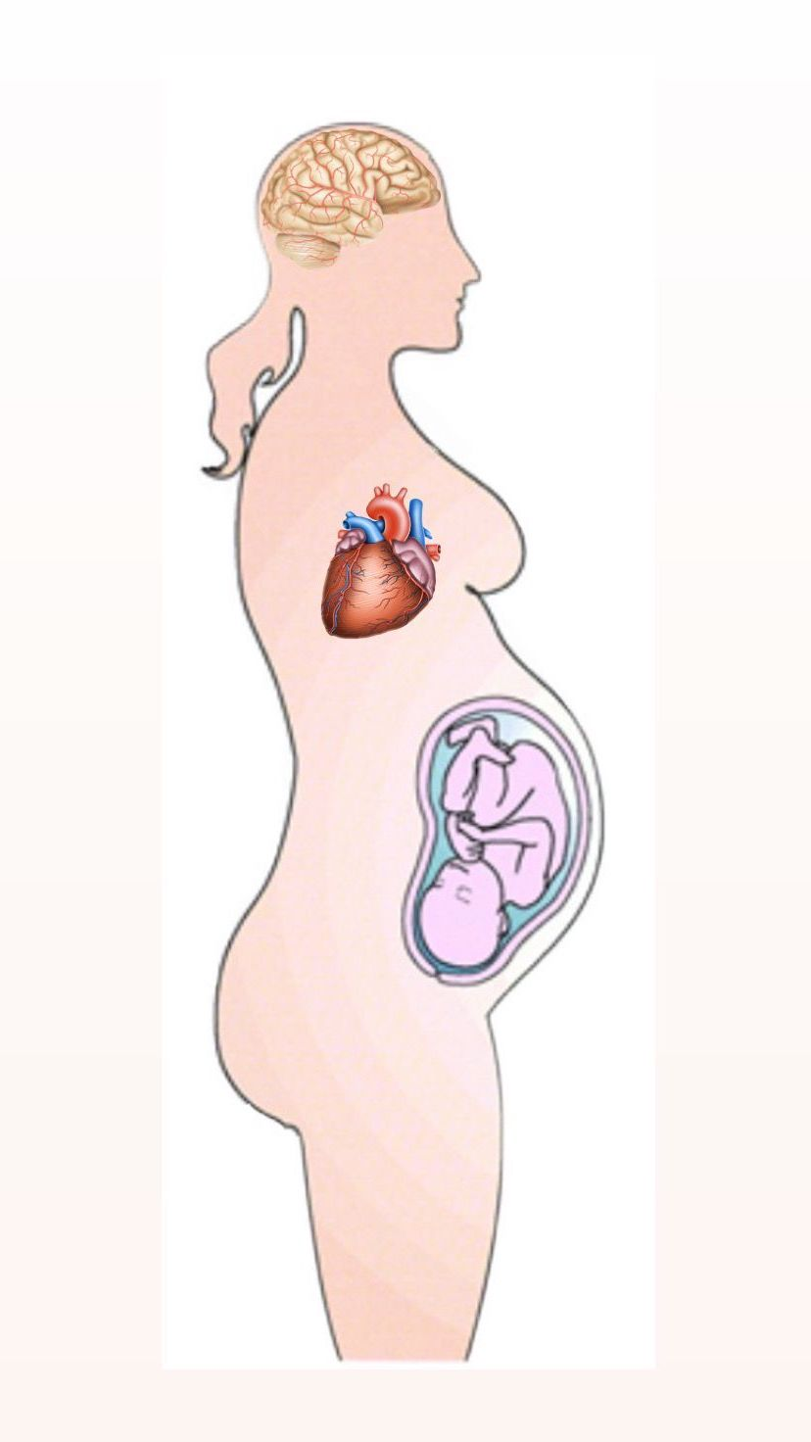
METHOD
Research on heart-brain interactions shows evidence of an impact of heart oscillations on altering brain waves.
–Research reported changes in brain waves caused by changes in cardiac activity [42,43,44,45]. 'Neural responses to heartbeats reveal residual consciousness after brain damage'[46].
–Research reported that the periods of signal bursts during temporal coordination of neurons registered by the magnetic resonance imaging (MRI) techniques repeated at the same rate as the heartbeat in participants asked to stay awake and stay still during brain screening. [47].
–Emotions and feelings imply bidirectional Brain-Heart Interaction and are prompted by ascending vagal inputs[48]. Research reported that in emotional arousal, emotional stimuli first alter heart oscillations, and only then the altered heartbeats stimulate a specific cortical response [49].
–The heart’s input alters cortical processes. Altered heartbeats impact cognitive functions, such as working memory and attention, depending on the nature of the heart’s input. [50,51,52,53,54].

Slide 12
RESULTS: Physics about Neuronal Nonlocal Coupling
The wave equation describes the propagation of electromagnetic waves (derived from Maxwell's equations).
According to Faraday's law, the electromagnetic field of a time-varying nature can induce internal currents in the space wherever it changes, for example in the brain tissues [55][56]. Magnetic fields (MF) and electromagnetic fields might have a similar mechanism, such as generating internal currents [55][56]. Charged particles exist among proteins and cells [55]. Hence, applying an MF externally could affect internal particles, and may thereby alter biological processes in cells [55].
Particles with the same physical properties react similarly to the electromagnetic field of the same features in similar environment, independent of the distance between these particles [47]
The heart's magnetic field is the strongest rhythmic field in the human body [48]. Normal human heart rates vary from about 45 to 220 beats/ minute (in Hertz, that would be from 0.75 Hz to 3.66 Hz), which is relative to the effective diapason of the frequency ranges for external electromagnetic waves to increase cortical excitability as research has already shown [55],[57].
According to Frohlich et al. [58], a neuroscience review shows that the delta wave amplitude in awake adults is under 15 μV and increases to 50 μV in the rapid-eye-movement sleep period [58]. Meanwhile, the amplitude of a person's electrocardiogram is generally within 5 mV [59], and average heart rates range from 60 to 100 bpm (1-1, 6 Hz, a similar range as the low-frequency brain waves). Heart waves are the body's most potent low-frequency electromagnetic oscillator, exceeding brain activity by three orders of magnitude.
where E denotes the vector field of electric induction, μ – the magnetic permeability of the medium, ε – the electrical permeability of the medium, ∇² is the Laplace operator, ∂²/∂t² – the operator of the second derivative with respect to time.
This equation describes how electromagnetic waves propagate through space. It allows us to determine the frequency, wavelength and propagation speed of the electromagnetic waves.

Slide 13
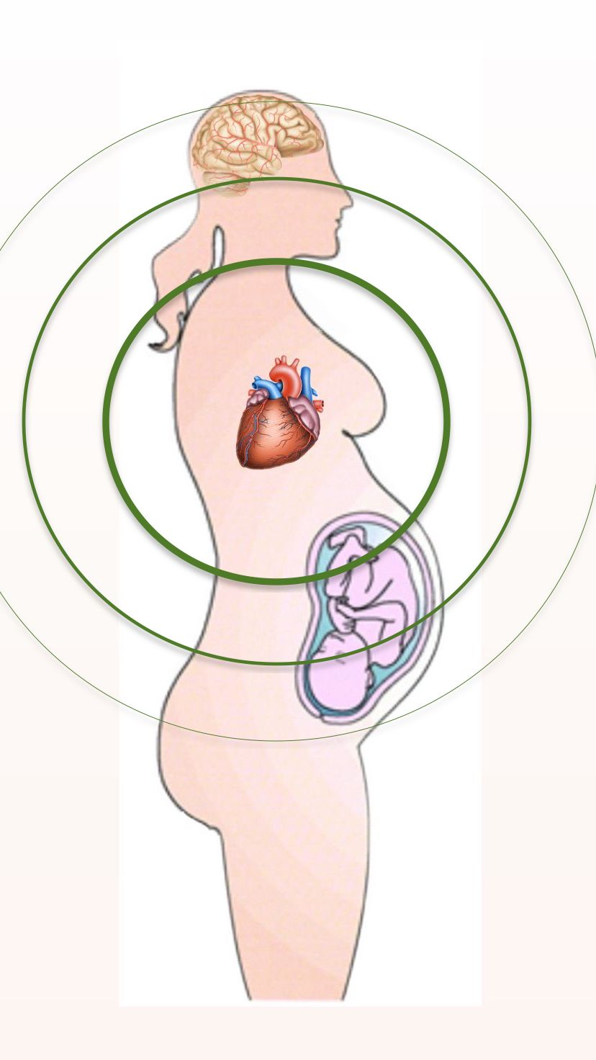
Discussion
A fetus cannot grasp perception independently. At the same time, evidence shows that fetuses can correctly respond to stimuli from the mother's external environment. The embryo's correct reactions to stimuli cannot be attributed to proper perception due to the above-mentioned problems of cognitive development. The shared intentionality hypothesis suggests that this relevant embryo's behavior can succeed due to the temporal coordination of the embryonal neuronal subsystems and those of the mother stimulated by oscillations of the mother's heart [47].
This viewpoint from physics on nonlocal coupling explains neurophysiological processes where the external low-frequency oscillator only involves relevant neural networks. The mother's heart oscillations consolidate locally fired neuronal networks in a choir to shape harmony from a cacophony of distinct oscillations [47]. It only syntonizes those already involved in local gamma-temporal coordination induced by interpersonal dynamics in the particular ecological context of the intentional act. In such a manner, the mother's oscillations can substantially affect gamma oscillations in coordinating and compressing neuronal activity in both organisms indwelling in the same ecological context, i.e. voice stimuli from the mother's environment. Due to nonlocal neuronal coupling, the mother's peripheral and central nervous subsystems become a template for the embryo[47].
The mother's heart oscillations can consolidate locally fired neuronal networks in both organisms. This choir shapes harmony from a cacophony of distinct oscillations.

Slide 14
Conclusion
Mother's heart oscillations can impact cortical excitability in the embryo, which alters its neuronal activity.
The mother's heartbeats can substantially affect gamma oscillations in coordinating and compressing neuronal activity in both organisms indwelling in the same ecological context, i.e. voice stimuli from the mother's environment. Due to nonlocal neuronal coupling, the mother's peripheral and central nervous subsystems become a template for the embryo.
Because of this template, the fetus can correctly choose sensory stimuli in developing perception that she can hear from outside the womb, that is, from the mother's environment.
From this perspective, the answer to the ageless argument is following: an embryo begins cognition due to psychophysiological entrainment to the mother stimulated by her heartbeats.

Slide 15
REFERENCES:
1. Zoia, S., Blason, L., D’Ottavio, G., Bulgheroni, M., Pezzetta, E., Scabar, A., Castiello, U.: Evidence of early development of action planning in the human foetus: a kinematic study. Experimental brain research, 176, 217-226 (2007).
2. Castiello, U., Becchio, C., Zoia, S., Nelini, C., Sartori, L., Blason, L., D'Ottavio, G., Bulgheroni, M. Gallese, V.: Wired to be social: the ontogeny of human interaction. PloS one, 5(10), p.e13199 (2010).
3. Sasaki, M., Yanagihara, T., Naitoh, N., Hata, T.: Four-dimensional sonographic assessment of inter-twin contact late in the first trimester. International Journal of Gynecology & Obstetrics, 108(2), 104-107 (2010).
4. Kisilevsky, B.C.: Fetal Auditory Processing: Implications for Language Development? Fetal Development. Research on Brain and Behavior, Environmental In uences, and Emerging Technologies, 133-152 (2016).
5. Hepper, P.G., Scott, D., Shahidullah, S.: Newborn and fetal response to maternal voice. Journal of Reproductive and Infant Psychology, 11, 147-153 (1993).
6. Lee, G.Y.C., Kisilevsky, B.S.: Fetuses respond to father’s voice but prefer mother’s voice after birth. Developmental Psychobiology. 56, 1-11 (2014).
7. Krueger, C,A., Cave, E.C., Garvan, C.: Fetal response to live and recorded maternal speech. Biological Research for Nursing, 17, 112-120 (2015).
8. Lecanuet, J.P., Granier-Deferre, C., Jacquet, A.Y., Capponi, I., Ledru, L.: Prenatal discrimination of a male and a female voice uttering the same sentence. Early development and parenting, 2(4), 217-228 (1993).
9. Hepper, P.: Behavior during the prenatal period: Adaptive for development and survival. Child Development Perspectives, 9(1), 38-43 (2015). DOI: 10.1111/cdep. 12104
10. Jardri, R., Houfflin-Debarge, V., Delion, P., Pruvo, J.-P., Thomas, P., Pins, D.: Assessing fetal response to maternal speech using a noninvasive functional brain imaging technique. International Journal of Developmental Neuroscience, 30, 159– 161 (2012). doi:10.1016/j.ijdevneu.2011.11.002
11. Collinet C, Lecuit T. Programmed and self-organized flow of information during morphogenesis. Nature Reviews Molecular Cell Biology. 2021 Apr;22(4):245-65. https://doi.org/10.1038/s41580-020-00318-6
12. Val Danilov I. Low-Frequency Oscillations for Nonlocal Neuronal Coupling in Shared Intentionality Before and After Birth: Toward the Origin of Perception. OBM Neurobiology 2023; 7(4): 192; doi:10.21926/obm.neurobiol.2304192.
https://www.lidsen.com/journals/neurobiology/neurobiology-07-04-192
13. Nunez, P. L. (2000). Toward a quantitative description of large-scale neocortical dynamic function and EEG. Behavioral and Brain Sciences, 23 (3), 371-398, discussion 399-437.
14. Bressler, S. L, Coppola, R., & Nakamura, R. (1993). Episodic multiregional cortical coherence at multiple frequencies during visual task performance. Nature, 366 (6451), 153-156.
15. Vinck M, Uran C, Spyropoulos G, Onorato I, Broggini AC, Schneider M, et al. Principles of large- scale neural interactions. Neuron. 2023; 111: 987-1002.
16. Buzsáki G. Rhythms of the Brain. Oxford, UK: Oxford University Press; 2006.
17. Fries P. A mechanism for cognitive dynamics: Neuronal communication through neuronal coherence. Trends Cogn Sci. 2005; 9: 474-480.
18. Bressler SL, Kelso JS. Cortical coordination dynamics and cognition. Trends Cogn Sci. 2001; 5: 26-36.
19. Varela F, Lachaux JP, Rodriguez E, Martinerie J. The brain web: Phase synchronization and large- scale integration. Nat Rev Neurosci. 2001; 2: 229-239.
20. Kope llN, Ermentrout GB, Whittington MA, Traub RD. Gamma rhythms and beta rhythms have different synchronization properties. Proc Natl Acad Sci. 2000; 97: 1867-1872.
21. Bonnefond M, Kastner S, Jensen O. Communication between brain areas based on nested oscillations. eNeuro. 2017; 4; ENEURO.0153-16.2017. Doi: 10.1523/ENEURO.0153-16.2017.
21. Buzsáki G, Vöröslakos M. Brain rhythms have come of age. Neuron. 2023; 111: 922-926.
22. Li KT, Liang J, Zhou C. Gamma oscillations facilitate effective learning in excitatory-inhibitory balanced neural circuits. Neural Plast. 2021; 2021: 6668175.
23. Mazzoni A, Whittingstall K, Brunel N, Logothetis NK, Panzeri S. Understanding the relationships between spike rate and delta/gamma frequency bands of LFPs and EEGs using a local cortical network model. Neuroimage. 2010; 52: 956-972.
24. Whittingstall K, Logothetis NK. Frequency band coupling in surface EEG reflects spiking activity in monkey visual cortex. Neuron. 2009; 64: 281-289.
25. Grover S, Nguyen JA, Reinhart RM. Synchronizing brain rhythms to improve cognition. AnnuRev Med. 2021; 72: 29-43.
26. Schroeder CE, Lakatos P. Low-frequency neuronal oscillations as instruments of sensory selection. Trends Neurosci. 2009; 32: 9-18.
27. Mably AJ, Colgin LL. Gamma oscillations in cognitive disorders. Curr Opin Neurobiol. 2018;52: 182-187. doi: 10.1016/j.conb.2018.07.009.
28. Herman PA, Lundqvist M, Lansner A. Nested theta to gamma oscillations and precise spatiotemporal firing during memory retrieval in a simulated attractor network. Brain Res. 2013; 1536: 68-87.
29. Fries P, Nikolić D, Singer W. The gamma cycle. Trends Neurosc 2007;30:309-316.
30. Fries P, Womelsdorf T, Oostenveld R, Desimone R. The effects of visual stimulation and selective visual attention on rhythmic neuronal synchronization in macaque area V4. J Neurosci. 2008; 28: 4823-4835.

Slide 16
REFERENCES:
31. Lee H, Simpson GV, Logothetis NK, Rainer G. Phase locking of single neuron activity to theta oscillations during working memory in monkey extrastriate visual cortex. Neuron. 2005; 45: 147-156.
32. Jacobs J, Kahana MJ. Neural representations of individual stimuli in humans revealed by gamma-band electrocorticographic activity. J Neurosci. 2009; 29: 10203-10214.
33. Lundqvist M, Herman P, Lansner A. Theta and gamma power increases and alpha/beta power decreases with memory load in an attractor network model. J Cogn Neurosci. 2011; 23: 3008-3020.
34. Lundqvist M, Herman P, Lansner A. Variability of spike firing during theta-coupled replay of memories in a simulated attractor network. Brain Res. 2012; 1434: 152-161.
35. Jeong WH, Kim WI, Lee JW, Park HK, Song MK, Choi IS, et al. Modulation of long-term potentiation by gamma frequency transcranial alternating current stimulation in transgenic mouse models of Alzheimer’s disease. Brain Sci. 2021; 11: 1532.
36. Gessi, S., Merighi, S., Bencivenni, S., Battistello, E., Vincenzi, F., Setti, S., Cadossi, M., Borea, P.A., Cadossi, R., Varani, K.: Pulsed electromagnetic field and relief of hypoxia-induced neuronal cell death: the signaling pathway. Journal of cellular physiology, 234(9), 15089-15097 (2019).
37. Robertson, J.A., Théberge, J., Weller, J., Drost, D.J., Prato, F.S., Thomas, A.W.: Low- frequency pulsed electromagnetic field exposure can alter neuroprocessing in humans," Journal of the Royal Society Interface, 7(44), 467-473 (2010).
38. Premi, E., Benussi, A., La Gatta, A., Visconti, S., Costa, A., Gilberti, N., Cantoni, V., Padovani, A., Borroni, B., Magoni, M.: Modulation of long-term potentiation-like cortical plasticity in the healthy brain with low frequency-pulsed electromagnetic fields." BMC neuroscience, 19, 1-6 (2018).
39. Antal A, Paulus W. Transcranial alternating current stimulation (tACS). Front Hum Neurosci. 2013 ;7: 317.
40. Antal A, Boros K, Poreisz C, Chaieb L, Terney D, Paulus W. Comparatively weak after-effects of transcranial alternating current stimulation (tACS) on cortical excitability in humans. Brain Stimul. 2008; 1: 97-105.
41. Wach C, Krause V, Moliadze V, Paulus W, Schnitzler A, Pollok B. Effects of 10 Hz and 20 Hz transcranial alternating current stimulation (tACS) on motor functions and motor cortical excitability. Behav Brain Res. 2013; 241: 1-6.
42. Zaccaro A, Perrucci MG, Parrotta E, Costantini M, Ferri F. Brain-heart interactions are modulated across the respiratory cycle via interoceptive attention. Neuroimage. 2022 Nov 15;262:119548. doi: 10.1016/j.neuroimage.2022.119548. Epub 2022 Aug 11. PMID: 35964864. https://pubmed.ncbi.nlm.nih.gov/35964864/
43. Park S, Ha J, Kim L. Anti-Heartbeat-Evoked Potentials Performance in Event-Related Potentials-Based Mental Workload Assessment. Front Physiol. 2021 Oct 18;12:744071. doi: 10.3389/fphys.2021.744071. PMID: 34733176; PMCID: PMC8558224.
44. Park S., Won M. J., Lee E. C., Mun S., Park M. C., Whang M. (2015). Evaluation of 3D cognitive fatigue using heart-brain synchronization. Int. J. Psychophysiol. 97, 120–130. doi: 10.1016/j.ijpsycho.2015.04.006
45. Schandry R., Montoya P. (1996). Event-related brain potentials and the processing of cardiac activity. Biol. Psychol. 42, 75–85. doi: 10.1016/0301-0511(95)05147-3
46. Candia-Rivera D. Brain-heart interactions in the neurobiology of consciousness. Curr Res Neurobiol. 2022 Aug 6;3:100050. doi: 10.1016/j.crneur.2022.100050. PMID: 36685762; PMCID: PMC9846460.
47. Val Danilov I. Shared intentionality modulation at the cell level: Low-frequency oscillations for temporal coordination in bioengineering systems. OBM Neurobiol. 2023; 7: 185. doi: 10.21926/obm.neurobiol.2304185.
48. McCraty, R.: Science of the Heart, Exploring the Role of the Heart in Human., 2, Published by: HeartMath Institute, Boulder Creek. (2015). ISBN 978-1-5136-0636-1 Paperback
49. Diego Candia-Rivera, Vincenzo Catrambone, Julian F. Thayer, Claudio Gentili, Gaetano Valenza. Cardiac sympathetic-vagal activity initiates a functional brain–body response to emotional arousal. Journal Article 2022, Proceedings of the National Academy of Sciences, e2119599119, 119, 21, doi:10.1073/pnas.2119599119 , PMID - 35588453, https://www.pnas.org/doi/abs/10.1073/pnas.2119599119
50. Hansen, A. L., Johnsen, B. H., & Thayer, J. F. (2003). Vagal influence on working memory and attention. International Journal of Psychophysiology, 48 (3), 263-274.
51. Lacey, B. C., & Lacey, J. I. (1974). Studies of heart rate and other bodily processes in sensorimotor behavior. In P. A. Obrist, A. H. Black, J. Brener, & L. V. DiCara (Eds.), Cardiovascular psychophysiology: Current issues in response mechanisms, biofeedback, and methodology (pp. 538-564). Chicago: Aldine.
52. Rau, H., Pauli, P., Brody, S., Elbert, T., & Birbaumer, N. (1993). Baroreceptor stimulation alters cortical activity. Psychophysiology, 30 (3), 322-325.
53. Sandman, C. A, Walker, B. B., & Berka, C. (1982). Influence of afferent cardiovascular feedback on behavior and the cortical evoked potential. In J. T. Cacioppo & R. E. Petty (Eds.), Perspectives in cardiovascular psychophysiology (189-222). New York, NY: The Guilford Press.
54. Van der Molen, M. W., Somsen, R. J. M., & Orlebeke, J. F. (1985). The rhythm of the heart beat in information processing. In P. K. Ackles, J. R. Jennings, M. G. H. Coles (Eds.), Advances in psychophysiology (Vol. 1) (pp. 1-88). London, England: JAI Press.
55. Huang, M., Li, P., Chen, F., Cai, Z., Yang, S., Zheng, X., Li, W.: Is extremely low frequency pulsed electromagnetic fields applicable to gliomas? A literature review of the underlying mechanisms and application of extremely low frequency pulsed electromagnetic fields. Cancer Medicine, (2022).
56. Barker, A.T., Jalinous, R., Freeston, I.L.: Non-invasive magnetic stimulation of human motor cortex. Lancet (London, England), 1(8437), 1106-1107 (1985). doi:10.1016/ s0140-6736(85)92413-4
57. Cameron, I.L., Markov, M.S., Hardman, W.E.: Optimization of a therapeutic electromagnetic field (EMF) to retard breast cancer tumor growth and vascularity. Cancer Cell Int.;14(1):125 (2014). doi:10.1186/s12935-014-0125-5
58. Frohlich J, Toker D, Monti MM. Consciousness among delta waves: Aparadox? Brain. 2021;144: 2257-2277. doi: 10.1093/brain/awab095.
59. Chen J, Pu H, Wang D. Artificial intelligence analysis of EEG amplitude in intensive heart care.J Healthcare Eng. 2021; 2021: 6284035. doi:10.1155/2021/6284035.

Slide 17
THANKS FOR ATTENTION
Igor Val Danilov
igor_val.danilov@acci.center
Academic Center for Coherent Intelligence
Physics about Cognition:
a Modern Approach to Ageless Argument

