Slide 1
Medication adherence among persons with Multiple Sclerosis; From observation to intervention
Team members:
Efrat Neter¹, Efrat Esterkin-Hubner², Anat Wolkowitz², Lea Glass-Marmor², Ariel Miller^{2,4}
¹ Ruppin Academic Center, Israel
² Multiple Sclerosis Center & Department of Neurology, Carmel Medical Center, Haifa, Israel
^{2, 3} Rappaport Faculty of Medicine & Research Institute, Technion Institute of Technology, Haifa, Israel

Slide 2
Content – from observation to intervention
Background
What is MS?
What is adherence?
Disease-Modifying Therapies (DMTs) for persons with relapsing-remitting multiple sclerosis (PwRRMS); Advantages & challenges
Observation stage:
Adherence to DMT and reasons for non-adherence
Identify useful/relevant theory
Intervention stage:
Description of Intervention
Acceptability, Feasibility and Efficacy
Intervention Mapping (IM) approach structured the process of design and implementation of intervention

Slide 3
Part I - background

Slide 4
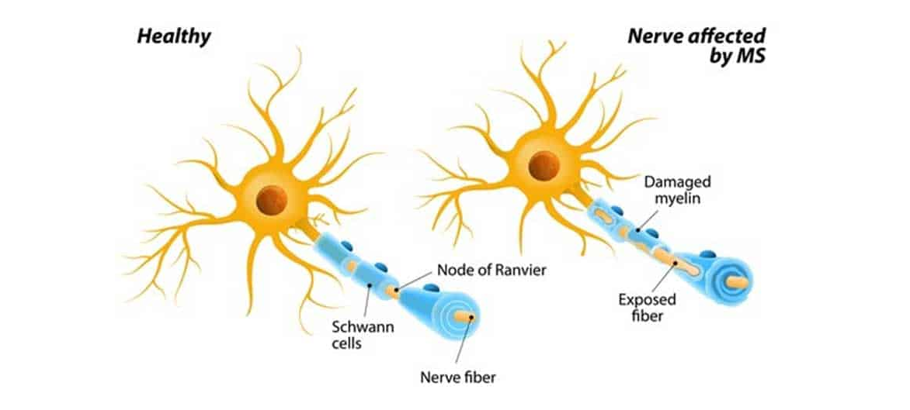
Multiple sclerosis
A chronic autoimmune disease of the central nervous system characterized by inflammation, demyelination, and axonal degeneration.
MS is a heterogeneous, multifactorial, immune­-mediated disease that is caused by complex gene–environment interactions.
Several sub-types; heterogeneous clinical manifestations and course
In most patients, reversible episodes of neurological deficits (known as relapses) that usually last for days or weeks characterize the initial phases of the disease (relapsing MS)
Over time, the development of permanent neurological deficits and the progression of clinical disability become prominent
Onset: 20-40 years old; ~0.1% prevalence (geography and latitude dependent)

Slide 5
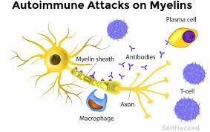
Disease Modifying Treatments (DMTs)
Modify the course of MS through the immune system; available for people with relapsing-remitting multiple sclerosis (RRMS)
Prescription by physicians is determined by: safety, efficacy, tolerability and QoL
Currently many options
Pharmacological effects, though,
depend (also) on medication taking behavior

Slide 6
Advantages of Disease-Modifying Therapies (DMT)
DMTs - currently a mainstay of treatment strategies to persons with RRMS (PwRRMS),
Effective in terms of disease progression
limit the number of relapses,
prevent new lesion formation,
decrease in neuropsychological issues,
reduce the accumulation of disability
slow progression of disease.
Adherence to DMT associated with
improved quality of life,
fewer days of work loss,
reduced hospitalizations, emergency visits, outpatient visits,
reduced annual medical care costs at the societal level.
Adherence especially important in a chronic condition, when disease onset is at an early age, requiring many years of treatment.

Slide 7
Challenges in Disease-Modifying Therapies (DMT)
Need for DMT not seem clear in times of disease inactivity or mild course (progression is unnoticeable to PwRRMS)
Chronic symptoms are not reduced by DMTs
(other/additional medications address them)
Benefits of treatment only accrue long-term
Adverse side effects are immediate
Adherence?

Slide 8
Medication taking behavior - Definitions
Adherence - the extent of correspondence between medication taking behavior and the recommendations made by the provider with respect to
timing,
dosage, and
frequency
Persistence - staying on same medication/treatment.
Switching – moving between medications.

Slide 9
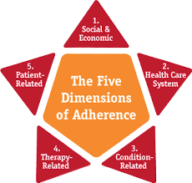
Adherence and persistence rates in MS
Recent meta-analysis (Nicholas et al., 2020) on oral DMT adherence:
before one year of treatment, 20% of PwRRMS were not taking it as prescribed (i.e., non-adherence),
one in four PwRRMS discontinued treatment (i.e., non-persistence.
Rates of adherence to injectable DMT ranges 25-50% within 1-5 years.
Reasons for non-adherence - WHO model.
In MS, most studies focused on social-economic or therapy-related factor (e.g., administration modality) factors.
Reasons were both intentional and non-intentional

Slide 10
Part II –
Observation

Slide 11
Intervention Mapping (IM) approach – structures the road towards intervention
Step | Tasks | Based on
1 Needs Assessment | Establish the extent of the non-adherence; Identify behavioural and environmental determinants associated with the non-adherence | Literature review; Longitudinal observational study investigating predictors of non-adherence
2 Identify Intervention Objectives | Identify expected outcomes and performance objectives for intervention; Establish targeted behavioral determinants | Needs Assessment (stage 1); Perceptions and Practicalities Approach (PAPA);
3 Theory-based methods and practical strategies | Select or design practical applications to deliver change methods; Select theory and evidence-based intervention methods based on pre-identified determinants | Literature review; Perceptions and Practicalities Approach (PAPA); Necessity-Concerns Framework (NCF); Motivational interviewing
4 Develop intervention | Integrate these practical applications into an organized program; Establish the format of the intervention; Draft and refine materials (consult with intended users) | Patients input; Clinicians; Research team
5 Implementation and evaluation plan | Identify intended users/targets; Develop indicators and measures for assessment; Evaluation plan | Methods
6 Implementation |  | Results

Slide 12
Stage 1: Measuring adherence prospectively
Compared adherence rates by
various measures/methods [electronic pharmacy records (MPR), patient-reported scales, and electronic medical device (EMD]
across time
two administration routes of DMTs – oral and self-injected
Examine association between measures of adherence.
Patient-reported yielded the most variance; EMD – failure (own device and pharma’s).
Moderate consistency across time (within-person): 84% agreement, Kappa=0.47, < 0.70 (=criteria in test-re-test)
No difference across modalities
Moderate-to-high % agreement between measures: 80% agreement (MPR & PRO, translating into Kappa=0.37)

Slide 13
Stage 1: Measuring and predicting adherence prospectively – key findings
Adherence range: 63 - 66% (depends on modality, brand, time)
Medication perceptions – the consistent predictor of adherence (across times, modalities)
Within-person variability

Slide 14
Stage 1: Key determinants of DMT non-adherence and non-persistence identified by the needs assessment
)
Determinant | Barriers/ Facilitators to DMT adherence/persistence
Medication beliefs | Concerns, necessity, harm, overtreatment (Horne et al., 2013; Neter et al., 2021; Thach et al., 2017)
Side effects | Reduced quality of life (Bruce & Lynch, 2011(
Treatment satisfaction | Thach et al., 2017; also, not MS-specific, Barbosa et al., 2012
Affective states | High levels of anxiety and depression (Bruce et al., 2010; Neter et al., 2021; Schoor et al., 2019)
Memory | Bruce et al., 2010; Horne et al., 2019
MS knowledge, self-efficacy | Conn & Ruppar, 2017; Costa et al., 2015
Main theoretical framework chosen: Perceptions and Practicalities Approach (PAPA)

Slide 15
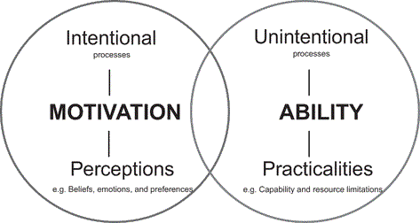
Perceptions and Practicalities Approach (PAPA):
motivation and ability as core intrinsic attributes for adherence.
Horne, R., Cooper, V., Wileman, V., & Chan, A. (2019). Supporting adherence to medicines for long-term conditions: A perceptions and practicalities approach based on an extended common-sense model. European Psychologist, 24(1), 82–96. https://doi.org/10.1027/1016-9040/a000353

Slide 16
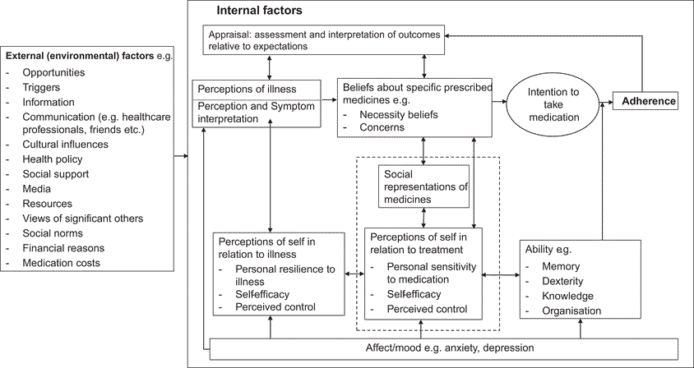
Perceptions and Practicalities Approach –
a detailed conceptual map of adherence.
Horne, R., Cooper, V., Wileman, V., & Chan, A. (2019). Supporting adherence to medicines for long-term conditions: A perceptions and practicalities approach based on an extended common-sense model. European Psychologist, 24(1), 82–96. https://doi.org/10.1027/1016-9040/a000353

Slide 17
Stage 2: Identify Intervention Objectives
)
The obvious: increase adherence.
Target would depend on power and N.

Slide 18
Stage 3: Select or design practical applications to deliver change methods
)
Meta-analyses (Conn et al., 2016, 2017) recommendations:
face-to-face interventions.
Focus on behavioral strategies and less on knowledge and beliefs.
Medication taking interventions among PwMS
focused mostly on persistence or re-initiation, not on adherence.
the reported interventions were tailored, using either digital tools or motivational interviewing (MI), delivered either via telephone or face-to-face.
studies on adherence did not find the interventions efficacious or were very small (N).
Decision: f2f Motivational interviewing;
also include education component.

Slide 19
Motivational interviewing
)
a patient-centered, evidence-based psychological counseling method
aimed at exploring and resolving ambivalent feelings and perceptions regarding behavior change.
has grown in use across diverse health settings in order to support behavior change,
including medication adherence,
including among individuals with MS.

Slide 20
Part III –
Intervention

Slide 21
Acceptability, Feasibility and initial efficacy study (a pilot)
)
Carried among identified non-adherent individuals, designed as tailored to the specific reasons of non-adherence, aiming at empowering PwRRMS.
RQs:
Did the developed intervention increased adherence?
If ‘Yes’, whether changes also took place in
medication habit
beliefs about medications.

Slide 22
Methods, Stages 4 & 5
Intervention development &
implementation

Slide 23
Participants
)
All PwRRMS in an observational study (n=230) screened for eligibility.
Enrolled if eligible and agreed.
Eligibility criteria:
being prescribed oral/injectable DMT (Fingolimod, Dimethyl Fumarate, Interferon beta-1a and Glatiramer Acetate, Teriflunomide) for > 6 months
identification as non-adherent by self-reports or medication claims records.
Exclusion criteria:
discontinuation of the medication on which non-adherence was identified,
being non-Hebrew speaking
Decision to participate in the intervention was determined jointly by the PwRRMS and the attending physician.
91 PwRRSM were identified as eligible, 60 enrolled (Visit 1), 52 completed the intervention (Visit 2) and 46 also completed the 12-months follow-up.
230 screened
91 eligible
62 consented,
60 enrolled
52 completed intervention
46 completed follow-up

Slide 24
Design and Ethics
)
quasi-experimental pretest posttest and a follow-up assessment;
assumed a moderate degree of recruitment consent and retention;
Anticipating we may end up with 40 participants at follow-up, a power of 0.79 was estimated to be sufficient to identify a difference of 0.45 standard deviation (effect size) at a 0.05 significance level.
IRB #NCT02488343; registration (ClinicalTrials.gov) IDCMC-14-0061-CTIL)

Slide 25
Procedure
Identification
Visit 1, Baseline
Telephone booster,
7-10 days after baseline
Visit 2, Reinforcement & conclusion of intervention, 6 months after baseline
Education & Motivational interviewing.
Psycho-education:
Education carried out by the treating neurologist,
Behavioral, utilizing Motivational Interviewing (MI), carried out by a health psychologist.
Motivational interviewing.

Slide 26
Procedure – educational content of intervention
Visit 1: the neurologist
brief explanation on MS,
review of the participant’s medical status (show PwMS’ recent MRI),
a review of scientific evidence supporting the benefits of specific medication taken by the participant (delayed progression of disability, reduced proliferation of lesions, sustained cognitive ability),
a discussion of potential side effects with a focus on those experienced by the participant and strategies for reducing them.

Slide 27
Procedure – Behavioral content of intervention
Visit #1, MI –
experiences of coping w/ MS,
goals and hopes for life w/ MS,
pros and cons for DMT use/non-use/partial use,
cases of recent missed doses reviewed;
potential strategies for medication adherence (e.g., participants identified personal high-risk situations of a missed dose);
a behavioral analysis of a typical missed dose;
coming up w/ ways of preventing circumstances leading to a missed dose.
Median time 30 min.
A pre-scheduled telephone booster, 7-10 days later.
Missed doses analyzed,
the importance of adherence and participant's self-efficacy were reinforced,
the main behavioral change techniques (BCTs) agreed upon in the previous session (Visit 1) repeated.
Median time 11 minutes.
Visit #2, MI, ~20 min, .....

Slide 28
Materials
)
Main outcome: Medication adherence (ProMAS), assessed at baseline (Visit 1), 6 and 12 months after baseline.
18-item of adherence behaviors, (e.g., “I have never changed my medicine use myself”, “When I am away from home, I occasionally do not take my medicines”). Internal reliabilities $− α$ = 0.83, 0.82 and 0.83 at Visit 1, Visit 2, and follow-up, respectively.
Expanded Disability Status Scale (EDSS)
Other PPOs: medication habits, beliefs about medication, illness perceptions, affective states, and quality of life.
Psychologist’s perception of the importance the participant attached to medication adherence and perceived efficacy (importance and efficacy ‘rulers’ within MI), ranging 1-10.
Demographic details (age, sex, education, social-economic status, self-rated health), retrieved from the observational study.

Slide 29
Results, Stage 6

Slide 30
Participants’ characteristics
PwRRMS were predominantly women,
Assessed their health as below average (Mean = 1.95 on a 5-point scale),
Physical disability (EDSS) was relatively low-to-moderate (Mean=2.78, SD=1.99, Median=2.50, IQR=1.00 – 4.00).
Mean MS duration 8.80 years.

Slide 31
Recruitment (acceptability) and retention in the intervention
91/230 identified, 62 consented, and 60 actually completed MI in first visit
No difference between consenters and decliners in demographics and clinical characteristics
N of sessions attended associated with
low SES (more session – low SES)
affective states (more depression and anxiety), lower QoL, worse illness perceptions

Slide 32
Primary outcomes: Self-reported medication adherence
Follow-up (12 months after BL) | Visit 2 (6 months after BL) | Visit 1, Baseline
10.69 (4.80) | 10.90 (4.67) | 9.74 (4.35) | Mean (SD)
11 | 12 | 10 | Median
Paired comparisons using Wilcoxon Signed-Rank non-parametric test
Significant effect, d=0.26
Non-significant effect, d=0.22

Slide 33
Auxiliary outcomes: medication’s habit and beliefs and rating of importance and efficacy
Habit and beliefs: No significant differences were found between at Visit 1 and Visit 2 (P’s > .05).
Importance and efficacy ‘rulers’:
Significant differences in between Visit 1 and phone booster;
non-significant differences between Visit 1 and Visit 2 .

Slide 34
Conclusions

Slide 35
Main findings and comparison with lit
Intervention is feasible:
2/3 agreed,
~1/2 of those identified completed;
more retention among the worse-off psychologically Need for psycho-social support evident.
Efficacy:
Adherence increased at 6 months, then reverted at 12 months (‘triangle effect’).
Needs augmentation/additional boosters; blended approach recommended
Small effect size, congruent with meta-analysis’ results.

Slide 36
Strengths
Tailored, personalized intervention to the specific participant, employing in-person sessions with 2 health professionals and demonstrating a commitment to extensive patient-provider communication
Utilized an intervention mapping approach. PAP theoretical model.
Long follow-up uncovered a fade-off.

Slide 37
Limitations
Small sample size
No control group (due to small N)
Upscaling could require structuring the intervention; less personal but maybe more digital tools
Communication outside clinic was restricted by HMO; policies changed since COVID.
EMA recommended, capturing times of need and provides options for prompts,
just-in-time response to a decrease in medication adherence;
could be integrated into patient support programs of pharma companies.
Need to tailor intervention to decliners. Qualitative work needed on reasons and needs.
Intervention addressed only patient and therapy-related factors and not healthcare system and condition-related.

Slide 38
Personal Note: Long Road …
Work started 10 years ago
IRB, registration, …
Still producing publications
Satisfying contribution
Neter, E. & Miller, A. (2023). Using an intervention mapping approach to improve adherence to Disease-Modifying Treatment in Multiple Sclerosis. International Journal of Multiple Sclerosis Care, 25 (5). doi: 10.7224/1537-2073.2022-018.
Neter, E., Glass-Marmor, L., Wolkowitz, A., & Miller, A., (2022). Medication habits among persons with multiple sclerosis. Multiple Sclerosis and Related Disorders, 68, 104224. doi.org/10.1016/j.msard.2022.104224
Neter, E., Glass-Marmor, L., Haiien, L., & Miller, A. (2021). Concordance between persons with Multiple Sclerosis and physician on medication effect and health status. Patient Preference and Adherence, 15, 939-943. doi: 10.21203/rs.3.rs-45699/v2
Neter, E., Glass-Marmor, L., Wolkowitz, A., Lavi, I., & Miller, A. (2021). Beliefs about medication as predictors to medication adherence in a prospective cohort study among patients with Multiple Sclerosis. BMC Neurology, 21, 136. doi:10.21203/rs.3.rs-45699/v1.
Neter, E., Wolkowitz, A., Glass-Marmor, L., Lavi, I., Ratzabi, S., Lejbkowicz, I., & Miller, A. (2020). Multiple modality approach to assess adherence to medications across time in Multiple Sclerosis. Multiple Sclerosis and Related Disorders, 40, 101951. doi: 10.1016/j.msard.2020.101951.

Slide 39
neter@ruppin.ac.il
Thanks to our participants
Thank you for listening.

Slide 40
Come to EHPS conference in Cascais, Portugal, September 2-6, 2024

Slide 41
WHO model of Medication adherence
Adherence is multi-factorial
Examples to dimensions/factors:
1 - age, education, marital status, having kids.
2 – access to care, out-of-pocket,
3 – lack of symptoms, severity of symptoms, addiction
4 – method of administration (pills/injections/..), time spent on trt, number of times/day,
5 – self care/management skills, efficacy, emotions, perceptions …..

